Slide 1
TIGRAY EMERGENCY COORDINATION CENTER OPERATIONAL UPDATE 07 February 2023

Slide 2
TIGRAY Region: ECC meeting 07 February 2023
Opening remarks
Action points from the previous meeting review
Key Sectoral updates
4. AoB –

Slide 3
Previous Action Points
Action points for next meetings | Responsible body | Status
Reminding all clusters to use of consistent ECC reporting template | OCHA/DRMC | Next meeting
Final IDP return plan | UNHCR/ERR | Next meeting
Meher multi sectoral assessment | OCHA/DRMC | Next meeting
Access mission to South and eastern zone | OCHA/UNDSS | Next meeting
Accelerated education plan | BoE/Education Cluster | Next meeting
Reminding all clusters to use of consistent ECC reporting template | OCHA/DRMC | Next meeting

Slide 4
Context update
Services (mobile, flights, banks, etc.) partially resumed in key towns, no commercial services.
Since the CoHA 147,878mt arrived, but 49% yet to be distributed.
Zonal HCFs activated, coordinating response, facilitating access, communications.
Access and road security assessments conducted, improved access, administration restrictions in crossline movements remain.
There was no comprehensive multi-sectoral joint assessment since 2020.
About 20% of health institutions partially functional, employees not paid salary for 20 months.
According health cluster average monthly GAM rate for the past six month was above 30%.
According to regional estimates there are about 2.5 million IDPs.
According assessment in September 2021 more than 88% of schools reported damaged and about 55,000 educational personnel not paid salary for about two years.
Annual fertilizer requirement 77,000 tons, response was 19,300 tons (25% of need) in 2022.

Slide 5
Food Cluster Update

Slide 6
Food Cluster – Key updates (as of 02 February 2023)
More than 128,700 MT of food has been brought into the region with more than 4 million people assisted since mid-Nov. 2022 (as of 03 February).
Food distributed to more than 262,000 recent IDPs (displaced since late August) in Abi Adi town, Adwa town, Adigrat town, Axum town, Hawzen town, Maichew town, Mekhoni town and Mekelle. Ongoing IDP verification is challenging and requires govt. support at all levels.
R2 of 2022: 5,098,711 people assisted with 85,428 MT of food in 82 woredas.
R3 of 2022: starting with Mekelle food distribution - 532,568 (118,197 IDP and 414,371 host community) assisted. Food dispatched to various woredas ongoing and distribution will follow accordingly.
According to Seasonal multisectoral Meher assessment total Population that Needs Humanitarian Assistance in 2022 is 6.5 Million
For Rounds of 2022, resources secured by the main food actors (WFP = 2.1 Million and JEOP=3.1 Million) = 5.2 Million (80% of the demand) .
Gap = 1.3 Million People (20% of the demand)
Data collection for the WFP-led Emergency Food Security Assessment (EFSA) is ongoing since late January.

Slide 7
Food Cluster – Key challenges and asks (as of 02 February 2023)
Food insecure people, particularly IDPs, require monthly food assistance instead of round based approach.
Sustaining the ongoing food assistance through the most appropriate modalities throughout the lean season, complementing it with support in agriculture and livelihood, market integration and early recovery in collaboration with other clusters is critical to improve food security in the region.
Humanitarian access to some remote areas off the main roads and/or in the extreme northern part of the region as well as locations that require crossline movements - for instance, distribution points in Adet, Egela and Naeder (Central); Erob and Gulo Mekeda (Eastern); and Dima (North Western).
Western Zone remains inaccessible for most partners, and information about the situation on the ground remains limited.
The cluster calls for continuous assurance from all parties in facilitating movement of humanitarian supplies and personnel through all corridors into Tigray as well as crossline movements within the region and allowing free and unimpeded access to affected populations.

Slide 8
Food Cluster – Key challenges and asks (as of 02 February 2023)
Timely verification and inclusion of vulnerable caseloads in food assistance has been one of the main challenges, particularly for urban displacement.
To support partners in providing timely and adequate assistance to the most affected populations with limited resources, the following is crucial in addition to full resumption of essential services (including banking, communication and other enablers) in all parts of the region.
Strengthening/re-establishing local government structures & the linkages between authorities at all levels,
Ensuring that civil servants, having not been paid for more than 18 months, receive their salaries, and
Resuming unrestricted flow of commercial supplies into Tigray
All food partners have to continue relying on humanitarian flights to bring cash into the region while banking services, gradually resuming in the main towns, is yet fully functional.

Slide 9
Agriculture Cluster Update

Slide 10
Contextual update
The provision of agricultural inputs (seeds, fertilizer, agrochemicals) to farmers remains a priority for the major three seasons:
Irrigation season (October 2022 – May/June 2023)
Belg season (March-June 2023)
Meher season (June-September 2023)
Zoonotic diseases outbreaks (Anthrax and rabies) on increase – more is required to arrest the spread and risks to both human and livestock
Agricultural cluster response is still very limited compared with needs on the ground
The agriculture cluster is appealing for immediate funding to restore conflict affected farmers livelihoods.

Slide 11
Needs and Responses
Crop Seeds (Staples & vegetables)
50,000 tons of staple(2%); 1,400 tons(0.3%) and 15 million sweet potato cuttings (60%)
Fertilizers
60,000 tons (Meher 2023) +17,000 tons (irrigation)
Response: 19,300 tons (25% of needs)
Irrigation infrastructures
26.6% of Irrigation infrastructure destroyed putting 18,000 ha (49,000hhs)
Response: None
FTCs
Required: 81% of 674 FTCs damaged & extension system non-functional
Response: None

Slide 12
Needs and Responses Cont.
Veterinary Vaccines
Required: 12 million doses
Response: 2 million(2021)
Veterinary Drugs
Required: 3.5 million doses treatment - max of 12 million prophylaxis
Response: >3 million doses(on distribution and in use)
Veterinary Equipment
Required: 198 Clinics
Response: 54 Clinics rehabilitated.
Rehabilitation of agriculture related infrastructures (Vet. Clinics, FTCs, fruit and tree nurseries, and irrigation infrastructures)

Slide 13
Challenges encountered
Limited resources for obtaining the required inputs due to huge funding gap
Inadequate supply of agricultural inputs (seeds, fertilizers, agro chemicals, farm tools).
Limited animal disease prevention and control activities due to lack of vaccines and drugs

Slide 14
Emergency Shelter & NFI Cluster Update

Slide 15
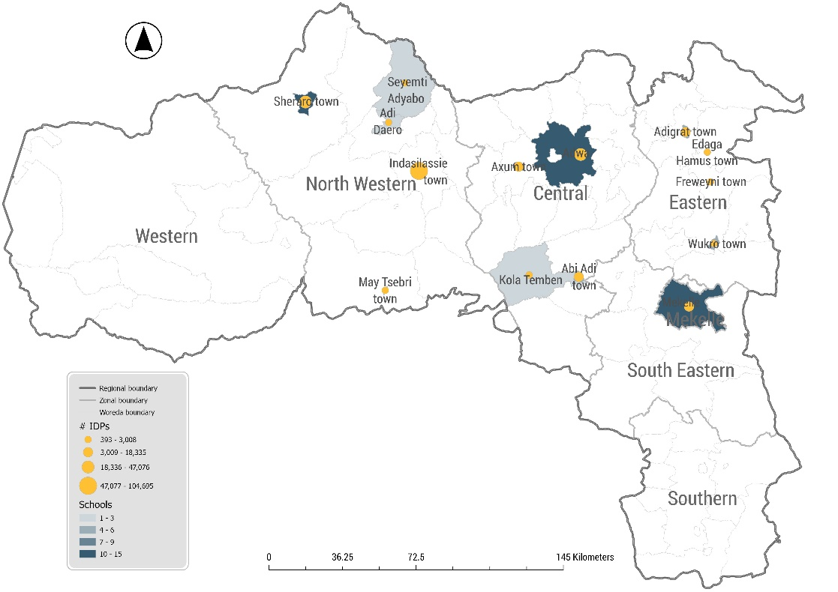
ES/NFI Cluster Plan for 2023
Total Target 1.2 M
Total Funding 42.7 M
18 Active Partners
Cluster Coordination
11 International
5 National
2 UN agencies
2 sub-national meetings in Mekele and Shire
Shelter Responses
Map schools occupied by the IDPs
Number of Schools – 77
Number of HHs – 51,932
Number of individuals – 256,186

Slide 16
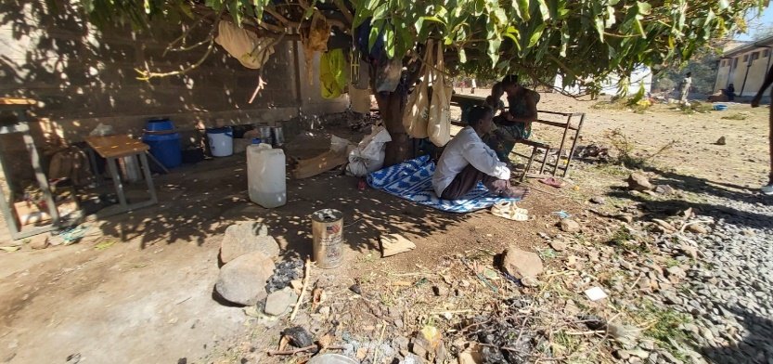
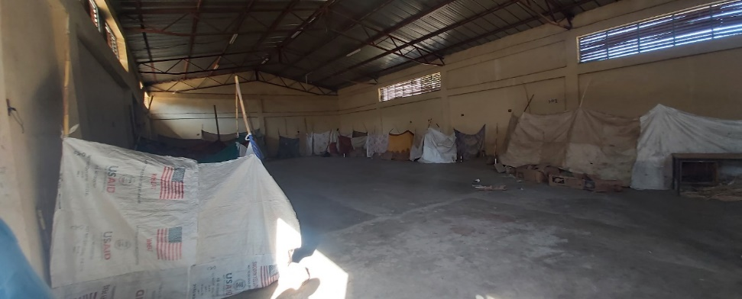
Situational Update
Tigray
Displacement and Responses
The resumption of the conflict towards the end of august 2022 within the region and along the borders resulted in mass displacement. The majority of them are still living in inadequate shelters mostly in open spaces, with host community families, collective centers, and unfinished buildings.
The majority of the response in 2022 and 2021 was the distribution of NFIs which resulted in the IDPs living inadequate living conditions.
Despite the government’s direction to return IDPs to their place of origin, still IDPs are living in very crowded rooms and open spaces in extreme need of shelter assistance.
According to the regional authorities (BoLSA and RDRM) most of the IDPs will be returned to their place of origin with the exception of ones displaced from the western zone and other inaccessible parts of the region until the situation is conducive enough for a return.

Slide 17
Situational Update
Tigray
Way forward
Challenges
Access remains a challenge to transport and distribute lifesaving supplies in some pocket areas of the region that are hard to reach.
Opening of schools and no pipeline for the Shelter responses
Limited Shelter related responses across all zone
Lack of ES/NFI Supplies in stock and pipeline for the newly displaced IDPs as well as returnees
Still no clear administrative structures in place for effective coordination, especially in remote woredas.
Alternative Shelter solutions such as Rental, Unused buildings, etc for the IDPs from the contested zones in coordination with CCCM and other sectors.
Development of IDPs site as a last resort ( resources, time exhaustive, etc.)
Supporting IDPs in the host communities through rental support and linking with livelihood actors.
Return related responses, training in HLP and building back better and coordinate with other sectors.
Coordinate with CCCM to decommission the schools occupied by the IDPs
Key Asks
Mobilize more ES/NFI supplies both in kind and through Cash.
Improving the service of financial institutes
Resources for relocation of the IDPs in the school and support the IDPs in the host community

Slide 18
Health Cluster Update

Slide 19
Health Situational Update
80% of the health institutions (80.6% HPs; 73.6% HCs; 80% Prim hosp; 85.7% GH/RF) partially or fully damaged/looted.
82 out 310 ambulances (26%) had remained b/c of looting/destruction
Health Information system is in total ruins
No budget for the health system for >2 years and the health workforce (>30,000) remained unpaid for > 20 months.
Pharmaceutical supplies (in 2022: only 5% of the needs)
- Program drugs/supplies: quantity lasts 1.5-2 months
- Non-program drugs/supplies: barely more than 2 weeks
➔ Drugs for NCDs, Laboratory reagents, IV fluids, Gloves, IV
antibiotics, Surgical Gauze etc.

Slide 20
Outbreaks:
- Malaria, Diarrheal illnesses, Zoonotic diseases (Anthrax & Rabies),
Typhus, HIV
Massive displacement
War casualties: non-combatants and combatants
Shocking number of Women who faced Gender based violence
Mortality figures shockingly very high
➔ Maternal Mortality Ratio: nearly 5 times higher than the pre-war time
➔ Neonatal Mortality: nearly 4 times higher than the pre-war time
➔ Infant and <5 children mortality: 2 times higher than the pre-war time
Conclusion:
Tigray has faced and is facing one of the worst health crisis and yet, it is receiving inadequate response. It is imbedded in the term Northern Ethiopia crisis!!! Its needs should never be equated with the other regions.

Slide 21
Nutrition Cluster Update

Slide 22
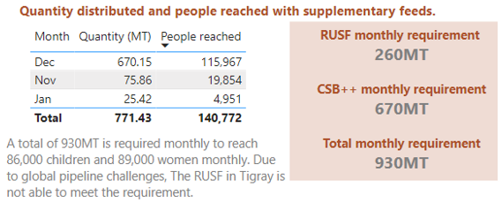
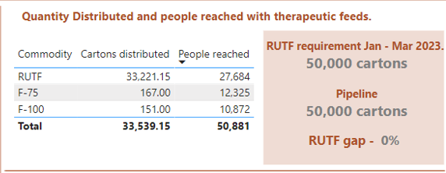
Nutrition weekly update
Week 4 23 -29 Jan 2023:-
Children under 5 Screened: 43,443 (22,156 girls and 21,287 boys)
Of the children screened 5% has severe malnutrition and 19% had moderate malnutrition therefore GAM was 24%.
PLW screened: 14,507 and 40% of these women were acutely malnourished.
A total of 2,483 SAM children were admitted for treatment (2,369 children were admitted to Outpatient care and 114 were admitted to Inpatient care.
Summary of Jan 2023 achievements
Indicator | Q1 target Jan-Mar | Achievement to date – Jan 2023 | Percentage
Number of Children with SAM admitted | 22,692 | 6,624 | 29% (on track)
Number of Children with MAM admitted | 51,444 | 9,441 | 18% (lagging)
Number of PLW malnourished to be supplemented | 30,936 | 10,680 | 35% (on track)
Supplies received Nov 2022 – Jan 2023

Slide 23
Challenges
Access to woredas in boarder areas continues to be a challenge for Nutrition partners.
Global market of RUSF affecting its availability for Tigray and the cluster is unable to meet 30% of the RUSF requirement.
Health workers welfare remains the biggest hurdle to the delivery of timely and quality health and nutrition services in their respective facilities.
Supply misuse as most of nutrition supplies are seen in the market.
Health facilities have lost basic equipment due to looting and destruction.

Slide 24
WASH Cluster Update

Slide 25
WATER SUPPLY
13,284 (72%) water supply schemes are damaged.
4.7 million people are out of access to safe water and exposed to water born related diseases.
63% of water points in schools are damaged.
76% of water points in health institutions are damaged.
Sanitation
1,561,255 people are in Priority 1 woredas for sanitation.
Desludging liquid waste remains a key priority to ensure the functionality of latrines.

Slide 26
Water source: due to the high number of non functionality water points, people are accessing water from unprotected water sources
Scale of response needs :is significantly high to address hot spot areas exposed to water born related diseases.
Supplies: For rehabilitation and maintenance of water supply system, chemicals to ensure safety of water quality are very limited
Funding for the WASH responses is still very limited with WASH partners.
Government structure is not fully functional: resuming the system is crucial to ensure durable solution and sustainability.

Slide 27
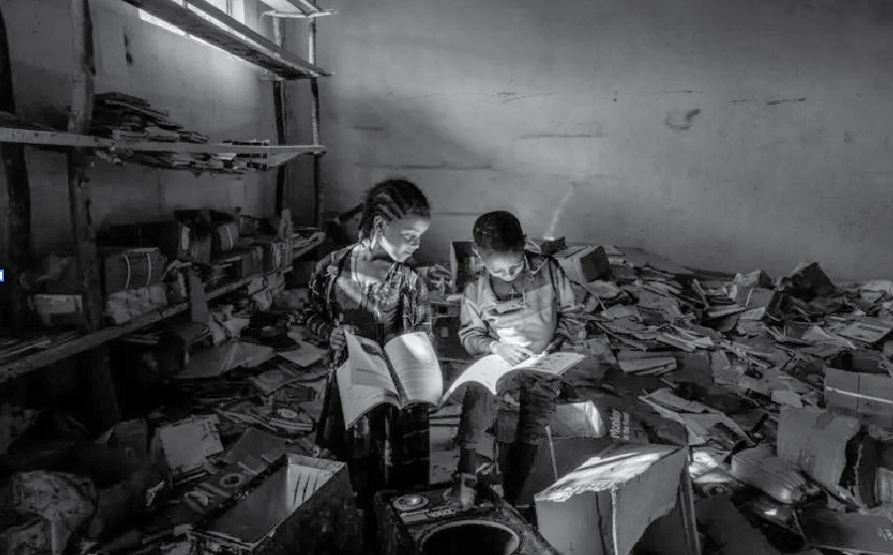
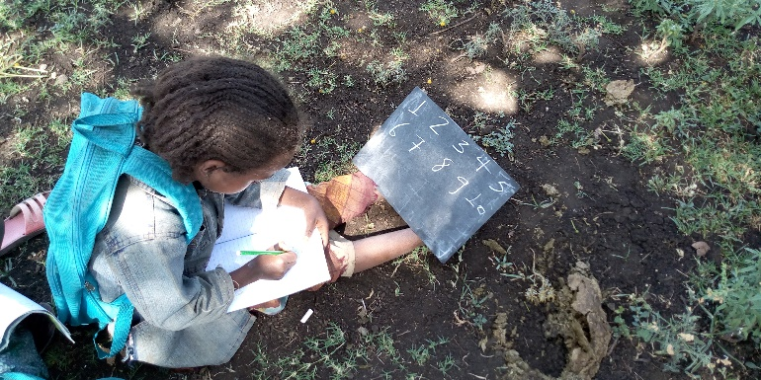
Tigray Education Bureau
Education Cluster What it Takes to Re-open Schools?

Slide 28
Situation of education in Tigray before crisis

Slide 29
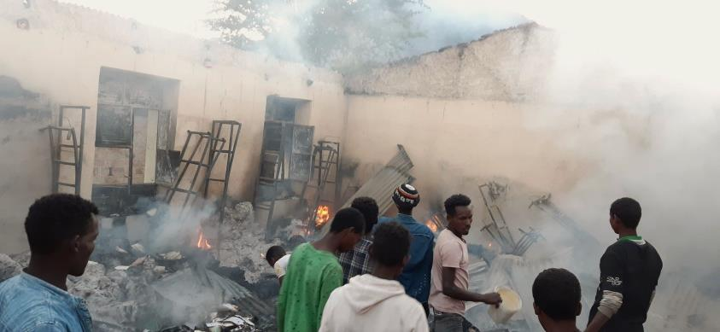
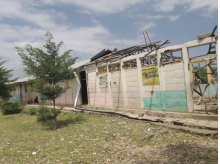
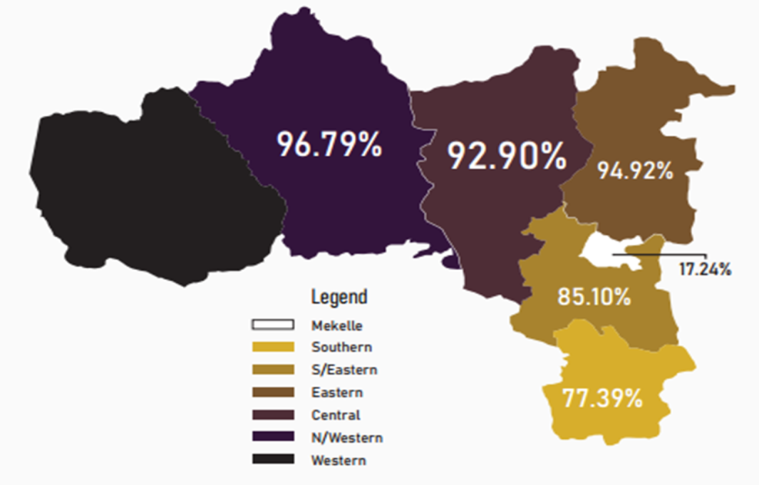
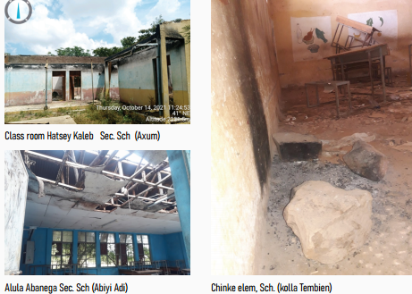
In 2021/2022 AY efforts were made to reopen schools up to grade 6 and it was possible to enroll 568,000, only 25% (with unaudited dropouts)
More than 88% of schools are damaged (Data, Sept. 2021; Western Tigray not addressed)
Currently close to 2.4 million children are out of school;
Around 55,000 educational personnel (Whereabouts not known; no salary for close to two years; demotivated and traumatized)
The educational structure from bureau to school level is non-functional
Abiy-Adi teachers college, completely damaged; Adwa (to be checked)

Slide 30
What it Takes to Re-open Schools in Tigray?
1.9M children, immediate assistance – (scholastic materials, including for students with special needs, school feeding, dignity kits for girls)
More than 88% of total schools need repair and maintenance/ TLS/reconstruction of classrooms & WASH facilities
Relocation/return of IDPs from about 95 schools and decommissioning of schools used as an IDP sites/ transit centre
Community mobilization and back to learning campaign
Clearance of explosive remnants of war (ERW)/UXOs and mine risk education
55K teachers and education personnel need PSS, pedagogy, condensed curriculum, Professional refresher training, peace building…

Slide 31
Cont’d
School furniture and blackboards (96% schools)
Salary/incentives for 55K teachers and education personnel
Investment to scale up complimentary teaching methodologies – Media (radio & TV), Digital education, distance and community based teaching models
Establishment of CFS/referral pathways for MHPSS and identification of children with protection needs in school
Financial Need
Total Immediate Funding Required to Start Schooling (2023): USD 619 Million (326/child)
Total Recovery and Reconstruction Funding Estimated: USD 1.2 Billion

Slide 32
What Minimum Conditions to be Fulfilled?
Returning IDPs to their previous habitats
Clearing UXOs and certifying schools
Salary of teachers
Reinstalling local administrations, thereby ensuring wereda education officers and school admins to be on workstation
Sustaining peace and security across Tigray

Slide 33
Protection Cluster Update

Slide 34
Protection: Situational Updates, Tigray
Cognizant of the slowly moving positive development following the Peace Agreement
The following are top ranked points of focus regarding protection:
Forced Migration and Displacements
More than 70,000 people migrated to Sudan
More than 2 Million new IDPs (multiple displacements of many)
Unspeakable atrocities of GBV
In front of their family; foreign objects in to reproductive organs; morally devastating words
Civilian protection crises (women, children, elderly & PWD left defenseless):
mass killings, abductions, displacement, rape, etc
Presence of Eritrean & Amhara forces within Tigray still posing the problems
Unaccompanied and separated children/ UASC
About 30,000 UASC: no education, no food, highly traumatized
Starvation and food assistance access and shortage
Of the PIN 7.9 Million (estimated total population in Tigray)
6.5 Million demand immediate food assistance
Being addressed so far 5.2 Million people, not enough

Slide 35
Demands
Support and justice for GBV survivors
Dignified returning of IDPs and migrants in Sudan
Compensation, intensive MHPSS, empowerment and rehabilitation
Family tracing and reunification of UASC in all woredas
More protection supplies: cash and bank service; food and medicine assistance
Civilian protection, vacating military from all civilian facilities and complete withdrawal of Eritrean and Amhara forces
Intensive mine action & mine risk education

Slide 36
CCCM Cluster Update

Slide 37
Focus on Abi Adi IDPs
Food, health and WASH services remain the highest needs in Abi Adi IDP sites.
No organized food has been distributed since August 2022.
Water trucking is done every other 10 days and each site receives 20,000 litres or less.
Partners assigned to provide health in the IDP sites were last seen in the sites in August 2022. Those who came thereafter had no supplies

Slide 38
Needs and Gaps
Service Availability in Abi Adi IDP sites
With the displacement that was experienced in October and November 2022, most IDPs have not received any food assistance.
Approximately 14,939 IDPs out of 48,511 IDPs in sites managed by CCCM partners have received food. Of which 12,172 received food in August 2022. Additionally, only 8,908 have been screened for food support. But not issued with the same.
Vulnerable groups include: - Pregnant and lactating mothers who constitute 11% of the population in the IDP sites. Children who constitute 34% of the population in the IDP sites. Elderly wo constitute 5% of the population
IDPs who arrived in October/November period have not received various NFIs: –
Essential household items
hygiene kits,
dignity kits.
There is one WASH partner in Abi Adi however the capacity of the partner is very low.
IDP sites in Abi Adi are provided with 20,000 litres of water every other 10 days.
Most of the latrines are full.
General sanitation activities are lacking.
Most of the sites are infested with bed bugs
Cases of screen rashes have been reported.
There is no scheduled health care program for the IDPs. Out of the 10 sites, only 5 have assigned partner. However, the partner is unable to provide the health services as needed by the IDPs.

Slide 39
CCCM Key asks for Tigray.
Decommissioning – With the expected resumption of learning, decommissioning activities will be required in all schools. The activities include repair of roofs, ceilings, fixing of doors, painting of classrooms, cleaning of compounds repair of perimeter fence and fixing of damaged gates among other CCCM decommissioning activities. A total of 122 schools have provided shelter to IDPs. This schools will require a minimum of 15000 USD to repair hence a total of 1,830,000 USD is required.
Relocations – Further with the resumption of learning, IDPs in schools will be expected to be relocated
non learning institutions. This relocations will require planning, reprogramming and reallocation
resources.
Care and maintenance – Given the fact that not all IDPs will immediately return to places of origin, those
still in collective centres will require assistance, the sites will also need to maintained and all services
provided.
d) Governance – Continuous coordination and governance activities will continue in all site which will be hosting
IDPs
e) Capacity building – In line with the localization strategy more local and national partners will need to be trained
and mentored on CCCM activities.

Slide 40
Tigray
Resumption of Cargo Movement to Tigray via three corridors
Semera – Mekelle, Kombolcha – Mekelle, Gondar – Shire
EDRMC - Logistics Cluster
Logistics Cluster
EDRMC
Addis Ababa, Ethiopia
Addis Ababa, Ethiopia
June 2022
January 2023

Slide 41
Logistics Cluster Updates
Since 15 November, the Logistics Cluster continues to support partners in securing the EDRMC Support Letter enabling cargo to move to Tigray.
Since the resumption of cargo movement, the Logistics Cluster has submitted 4,136 trucks for EDRMC Support Letter on behalf of 39 Partners.
As per partners’ report of arrivals, a total of 3,731 trucks carrying 150,398 MT of humanitarian supplies and 1,116,088 liters of fuel have entered Tigray via the three corridors.
Additionally, the Logistics cluster is facilitating free-to-user cargo flights for partners on the Boeing 737 and DHC-800 to Mekelle and Shire.
43 MT of Health and Nutrition items on behalf of 8 partners have been airlifted, in eight rotations
Moreover, the Logistics Cluster supports partners with transport and warehousing services from its two warehouses at both hubs - Mekelle and Shire.

Slide 43
Challenges:
Inadequate fuel supply in the region which can hamper the speed of dispatch of items from Logs Cluster warehouses, and can congest the warehouses
Limited visibility of partner pipeline which hampers Logs Cluster to prepare adequately

