Slide 1
TIGRAY
EMERGENCY COORDINATION CENTER
OPERATIONAL UPDATE
04 August 2023

Slide 2
TIGRAY Region: ECC meeting 04 August 2023
Opening remarks
Action points from the previous meeting review
UNMAS Briefing
Challenges and Asks on Tigray Relocation activities-CCCM Cluster
Key Sectoral updates
5. AoB

Slide 3
Action points for next meetings | Responsible body | Date
Joint Rapid assessment on reported death cases. | BoH/Health Cluster | Next meeting
DTM to present findings from recently conducted site assessment R33 and Village Assessment survey R16 | DTM/IOM | Next meeting
Desert Locust status | ATF | Next meeting
Rainfall forecast | ATF | Next meeting
Clusters to report on the impact of food pause | All clusters | Next meeting
Flood contingency preparation plan by partners to be submitted to DRMC | All partners/RDRMC | Next meeting

Slide 4
Tigray ECC Operational Update on
Challenges and Asks on Tigray Relocation activities
CCCM Cluster
4th August 2023

Slide 5
Challenges and Asks on Tigray Relocation activities
Since the eruption of the conflict in Northern Ethiopia (Tigrai), many school IDPs have been hosting IDPs as Transit and Collection Centers.
Sebacare4 (Mekelle), Five Angels, Mai Dimu( Shire) and Ade-Abay (Sheraro) and Ex-UNMEE in Adi Grat and Adwa Industrial Zone ( Adwa) are the only planned camp settings in the Region.
Since the onset of the conflict CCCM cluster managed a total of 168 sites of which 108 (65%) were educational facilities.
Out of the 108 Educational facilities 36 have been closed with limited or no decommissioning works.

Slide 6
Schools accommodating IDPs In Tigray and possible solutions
Those closed include (24 Primary Schools 11 Secondary Schools 1 College)
Open school facilities in the region tally 72 (66%) out of the existing 108 open IDP sites with a total of 281,264 IDPs being hosted.
Relocation, Consolidation of sites and Out of camp assistance also known as Area Based Approach and Returns are the alternatives available for most of the displaced persons.
The Area Based Approach and Returns require substantial programming shift and allocation of resources.

Slide 7
Open/Active Sites and the CMAs
ANE/UNHCR- 03 Colleges, 10 Primary School, 07 (Secondary School) = 20 | SENE-02, Primary School, | TYES 02 Primary School,
OSSHD/UNHCR 03 (Colleges) 08 (Primary School) 03 (Secondary School) =14 | SRO- 02 Primary School, UNHCR-02 | BF/Bright Future-02, Primary School
IOM- 10(Primary School) (Secondary School) =19 | HoH 01 Primary School, | HOP-04 (Primary School)02 (Secondary School) =06
7

Slide 8
Relocation activities in Mekelle
Relocation task force was established 2021.
Community consultation and ‘’Go and See Visit’’ for IDP leaders is normally conducted jointly with Protection Cluster.
Other cluster members include Food, ESNFI and WASH.
The government interface includes but not limited to lowest BoLSA offices/sub city level.
The cluster partners avails resources interalia for transport, coding/packing of IDPs Items, registration and listing based on the approved list by the government.

Slide 9
Challenges encountered by the cluster
In Mekelle IDPs in 19 schools need to be relocated however, there is general apathy by IDPs to relocate to SB4, IDP students are currently enrolled in schools where they are residing hence moving to SB4 will cause distraction to their learning.
Elshadai has availed its facility for possible relocation however, it needs resources to carry out partitioning and construction of WASH facilities.
In Shire IDPs in 12 schools have been earmarked for possible relocation to Mai Dimu site. The site has an intake capacity of 20,000 individuals. The major obstacle is electricity – for security, and for cooking. There is need to install a transformer and other domestic cabling in the site.
In Sheraro IDPs in 7 Schools are earmarked for relocation to Adi-Aba IDP site. The site has 339 duplex shelters out of the planned 2,016 Duplex Shelters.
Adi-Grat- 02 Schools- No relocation site is availed
Abi-Adi—06 Schools- No relocation site is availed
Axum- 08 Schools- AXU Referral Hospital.
Mai-Chew- No Relocation site is available.
9

Slide 10
Relocation Sites and Opportunities
Relocation Site | Intake capacity | Occupancy | Expansion Capacity | Target Population for relocation | Targeted school for Relocation | Service availability at the center | AoR/Woreda
Mai Dimu | 4000HH,20000 ind | Unoccupied | Yes |  | 13 | WASH, HEALTH, Protection, | Shire
Adi Abay | 3,600 HH/18,000 Ind/2,016 Duplex Shelter | 560HH/394 Duplex Shelter | 300 Duplex Shelters |  | 05 | WASH, HEALTH, Protection | Sheraro
AXU COVID treatment Centre | 4,000 | Unoccupied | 0 |  | 04 | WASH, HEALTH, Protection | Axum
TVET/Shade | 1,200 HH | 705 HH | 100 shelter |  | 03 | WASH, HEALTH, Protection | Abi-Adi
Edaga Hamus warehouse center | 230 HHs | Unoccupied |  |  | 01/230 HH | WASH, HEALTH, Protection | Edaga Hamus
EXUNMEE/AIZ | 314/1080 | 314/680 | 0/80Shelter Unit |  | 05/05 | WASH, HEALTH, Protection | Adi-grat/Adwa
Seba care4 | 3365 | 2227 | 600 |  | 07 | WASH, HEALTH, Protection, | Mekelle
9

Slide 11
Concerns and key asks.
IDP Community Resistance In Mekelle, despite the Government and Cluster efforts on Consultation.
Key Ask- To reactivate the relocation consulting the community on the necessity of school reopening and relocation.
Lack of Resource/response to IDPs key asks up on relocation; Food, alternative source of energy (available
Key ask-advocacy/Resources on the IDP Asks.
There is need to allocate more resources to Area Based Approaches or Out of Camp interventions which include rental support. This will effectively solve the issue of IDPs in schools.
Key Ask- Cash for rent for IDPs living in the host community and reinforcing ABA
There is need to revamp the return and durable solutions actions. This will create alternative displacement solutions for IDPs.
Key Ask- Cash for rent, resumption of assisted Return, advocacy to relocate IDPs
based on head count to Master list.
11

Slide 12
Concerns and key asks
Review capacities of existing IDP site and their potential to accommodate more.
Integrated resource mobilization to areas where relocation, consolidation and or Area Based Approaches are being implemented.
Government to avail sites it has control of to be used for relocation.
Government provide adequate security in all relocation sites.
Key Ask- learning guarantees at SB4 site, safety and security
12

Slide 13
Food Cluster Update

Slide 14
Food Cluster Key Updates as of 03 August 2023
During this critical time, the regional govt is working to improve coordination with EDRMC. As the main food partners’ pause of distribution is entering its fourth consecutive month in Tigray, the Government is organizing a one-off distribution to support IDPs in 17 towns with around 3,100 MT of food items. The commodities continue to arrive in the selected towns, the distributions targeting the most vulnerable IDPs are expected to take place in early August.
  EDRMC allocated resource: 3,108 MT (Rice 1,831MT, CSB 982 MT and Oil 295 MT)
  Ration: Rice 5kg/person, CSB 4.5kg/person and oil 0.45lit/person
  Based on allocated resources - rice enough for 366,284 IDPs, CSB for 218,185 IDPs, and oil for 654,553 IDPs
  Dispatched: 1,890.84 MT (61%)
While the pause of most food assistance activities continues, food partners gradually started trialling the improved processes. This testing phase will give an opportunity for partners to evaluate the enhanced measures and controls jointly put in place and further strengthen the system prior to any wider distribution.
  Small-scale test distributions are being conducted at 7 rural food distribution points in NW Zone (1 in Asgede, 2 in Tsimbla, 1 in Tahtay Adiaybo) and Southern Zone (3 in Raya Azebo) since 31 July. As of 03 August, around 63,800 people were assisted by WFP and its partners with 957 MT of wheat from MoA, funded by WB (15kg pre-packed bag of wheat per person).
Data-driven, vulnerability-based targeting approach to identify most vulnerable families for upcoming food aid.
  JEOP: In Central, Eastern, South Eastern and part of Southern zones, data collection is completed in non-displaced communities in rural areas and urban towns, pending on IDP data.
  WFP: In North Western and part of Southern zones + Mekelle, the exercise is being rolled out in phases – Phase 1 currently ongoing in eight rural woredas (7 in NW and 1 in S), followed by Phase 2 and 3.
130
Notes:
<number>

Slide 15
Food Cluster Key Updates as of 03 August 2023
It is imperative for main food partners to start regular targeted food assistance as soon as possible with assurances that aid reaches the most at-risk families. The partners have been working with the communities and authorities to roll out data-driven targeting exercise, improve beneficiary data verification and management, strengthen commodity tracking and distribution procedures, and enhance monitoring as well as community engagement, including sensitization campaigns for clearly explaining new processes and reforms to all stakeholders.
Partners face several challenges during the targeting exercise, including but not limited to unavailability of community members during planting season, difficulties in asset and income estimation, cases of inflated family size, fluid population movements especially in displacement setting and urban areas, and lack of documentation among the displaced populations.
Partners are setting up more than 600 food distribution points in the region, particularly in rural areas, so that families can receive their food rations closer to home without having to travel long distance on foot or using animals with increased transport costs and protection risks. During last round of distribution (Round 3 of 2022), more than 243,000 people had to travel long distance to collect their food rations in alternative locations due to access constraints and infrastructural damages at the usual distribution points.
12
Notes:
<number>

Slide 16
Food Cluster Key Update as of 03 August 2023
There are great concerns over deteriorating food and nutrition insecurity among the vulnerable people in Tigray as the protracted suspension of most food aid continues during the peak hunger season (June - September).
Collective effort to monitor the situation, including joint verification of the unconfirmed death reports led by health professionals, and clarify any misinformation is paramount.
Lack of food assistance disproportionately affects displaced people, children, women and people with disabilities, exposing them to increased protection risks and psychosocial distress. It was reported by protection partners that shortage of food and other support systems has contributed to an increase in child separation from their primary care givers in recent months, including children who were reunified, some of whom are reported to re-separate and be back on the street.
Based on qualitative information on the ground, increased cases of begging have been observed particularly in major towns. Families are sending their children to engage in income generating activities, for example, petty jobs in cities and cattle herding/farming in rural areas, exposing children to high risks of exploitation and abuse. Some concerns were also raised in relation to increased likelihood of girls/women adopting harmful coping mechanisms.
Malnourished mothers are at a higher risk of experiencing complications during childbirth, and their babies are more likely to have poor health outcomes; a reduced dietary intake puts people at risk of malnutrition and micronutrient deficiencies like anaemia and weakens their immune systems, which heightens the risk of catching infectious diseases; and it was also reported that some displaced people with chronic illness, due to lack of food support, had to take their medication with empty stomach, which resulted in health complications.
12
Notes:
<number>

Slide 17
Food Cluster Key Update as of 03 August 2023
According to education partners, lack of food assistance is consistently raised by communities as an influencing factor in low school enrolment and poor attendance, specifically for displaced children and children with disabilities. Increased number of school-aged children are engaged in child labour within the host community (for instance, charcoal burning, farming or collecting scrap metal for sale).
Some families had to sell their non-food items in exchange of food as the priority and resort to compromised hygiene practices, making them more susceptible to illness, including malaria and waterborne diseases (ex: diarrhoea, cholera and typhoid). In the absence of food assistance, communities are more likely to sell other distributed humanitarian items to use the money to buy food.
To feed their families, some farmers are forced to leave their rural homes in search for food or sell the limited assets they have (ex: draught animals or breeding stock) for food, which negatively affect their cultivation compounded with serious shortage of agricultural inputs.
The suspension contributes to further displacement and pendulum movements of IDPs across the region due to lack of food in displacement sites. For instance, the recent IDPs in Endagabuna have not received food from main partners since their displacement in March. Additionally, the pause does not contribute to an enabling environment for sustainable return (both assisted and spontaneous) and durable solutions.
12
Notes:
<number>

Slide 18
Food Cluster Key Update as of 03 August 2023
Multi-sectoral support, including food assistance and agricultural inputs, is urgently needed to help displaced people return home and grow their own food during the ongoing Meher planting season. Scaling up support for agricultural production and early recovery activities is key to reduce food gaps and improve self-reliance in Tigray.
While the humanitarian space has improved in Tigray, food partners continue facing challenges in accessing some kebeles in Erob (Eastern), Zala Anbesa town (Eastern), Gulo Mekeda (Eastern), Egela (Central), Dima (North Western) and Tahtay Adiyabo (North Western) due to ongoing presence of armed actors and their movements along the international border and in contested areas.
The cluster continues to advocate for the removal of informal taxation along main trade corridors and unrestricted flow of commercial supplies into Tigray through all routes as it would help reducing the costs of essential goods in the market, and thus improving household purchasing power.
130
Notes:
<number>

Slide 19

Logistics Cluster Update

Slide 20

Plan for next week
N. | Activity Description | Operational location (woreda) | Plan (qty) | Available resources | Remark
1 | Consolidate truck arrivals into Tigray on the behalf of partners. | Semera - Mekele Gondar-Shire Kombolcha-Mekelle | Consolidating Weekly Report on Arrival of trucks with humanitarian cargo into Tigray |  | Partners to report timely Every Monday before COB
2 | Facilitate Warehouse Service | Mekelle and Shire | Upon request | Mekelle (3,500 m2), Shire (730 m2) | Subject to partner request and approvals from CO.
3 4 | Sharing Information Management Products to Partners Facilitate transport service inside tigray | Online | Weekly and Monthly | https://logcluster.org/ops/eth20a | Mid-year infographics Dashboard Meeting minutes Forms and guidance etc.
Notes:
<number>

Slide 21
Challenges
Partners not reporting on the arrival of their trucks on time.
Note: the weekly dashboards and reporting on item categories arrived in Tigray is based on:
  Item category description provided by the partners
  The weight (MT) reported in the dashboards reflects the total capacity of the truck which is reported by the partners.
  Access Constraint:
    Semera-Mekelle ( Accessible)
    Kombolcha-Mekelle (Volatile)
    Gondar-Shire (Volatile)
Notes:
<number>

Slide 22
Education Cluster Update

Slide 23

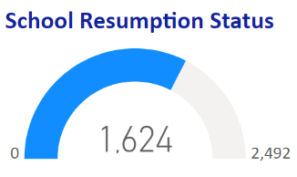
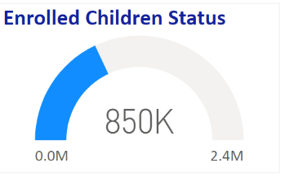
Tigray Education Cluster – Needs and Gaps
Opportunities
  JENA is being Conducted for better decision making
  Bi-Annual Review Workshop Conducted
  Tutorial for 10K Grade 12 students arranged for two months in the 4 Universities (Raya, Mekelle, Adigrat, Mekelle and Axum)
  School Principals from 2,492 schools are expected to attend training for two weeks.
  Donor Visits ➔ FCDO Next Week
Needs
Teaching Learning Supplies for 964K
School Supplies (Combined desks, blackboards, textbooks, chalk, office supplies)
Capacity building trainings on MHPSS and ALP(ALP or the government led Condensed Curriculum)
Support for System strengthening (Coordination, Planning, Information Management)
Reconstruction/rehabilitation
Temporary Learning Spaces and Materials for furnishing ALS
Back to school campaigns in the summer session
Gaps
552 schools are in an inaccessible woredas
110 schools are hosting IDPs and other groups
162 Schools are either fully damaged or are in the borders with Eritrea and Amhara
Notes:
<number>

Slide 24
Tigray Education Cluster – Response
No | Activity description | Plan (Needs or target | Achievement | % accomplishment (show the gaps) | Remark (explanation for over/under achievements
1 | Children reached with ALP and ASR intervention( IDP and Host community children reached with education and emergency services): I1D, WVI, SCI,PIE, SRO, DoC,TYES, | 100,000 | 54,886(27,659 Girls) | 55% | Schools have been closed for the summer vaccation
2 | School Feeding Services: IRC, PIE, DoC, SENEthiopia, SC, SRO | 26,000 | 5,901(2873Girls) | 23% | Program with WFP Delayed.
3 | Supplies Released to REB by UNICEF (Student kits, school in carton…) |  | 451
4 | School Supply Distribution (Desk/Blackboard) | 1500/200 | 60/35 | 4%/17% | Low Partners report.
5 | Number of children reached with TLMs(Teaching and Learning Materials or Education supplies distributed (SCI)-Schools Bags | 20,000 | 19,353 | 96% | Low Partners report
6 | Total Reach (Based on reports received) |  | 54,886(27,659 Girls)
Notes:
<number>

Slide 25
Cumulative plan Vs Accomplishments
Cluster Indicators/targetsTra | Cumulative plan (target) | Cumulative Reach (response) | Remark
Distribution of TLMs (Teaching and Learning Materials) | 964,000 | 335,526 | 35%
School Feeding | 174,000 | 7,526 | 4%
Back to school campaign/mobilization | 550,000 | 98,906 | 18%
Rehabilitation/establishment of TLS | 250 | 38 | 15%
Girls reached with MHM/sanitary supplies | 30,000 | 1649 | 5%
People reached with life-saving messages | 250,000 | 90,000 | 36%
AEP for crisis affected IDPs and host community | 70,000 | 108,365 | Large portion now integrated in formal school
Training on MHPSS | 11,000 | 1,252 | 11%

Slide 26
Tigray Education Cluster - Plan for next week
No. | Activity description | Operational location (woreda) | Plan (qty) | Available resources | Remark (any preconditions, support needs, etc)
1 | Continue School Feeding Services and start new school feeding program by WFP | Mekelle, Shire, Abiyi Addi, Hintalo, Samre, Keyih Tekli, Tanqua Melash, Zana, Seyemti Adiyabo, Tahtay Adiyabo | 26,000 |  | WFP School Feeding Program Will Start
2 | Continue provision of TLMs for emergency affected learners | All Zones (excluding Western) | 5,000 |  | Schools are closed and hence may be in the non-formal ones
3 | Distribution of combined desks/blackboards | Asgede, Abergele, Hintalo, Hawzen | 1500/200

Slide 27
Agriculture Cluster Update

Slide 28
Follow-up of the Seasonal Rainfall Forecast of Kiremti 2023 for Tigray
Monthly rainfall forecast for August and September of 2023 and Locust outbreak prediction
Yosef W/Rufael, CRS
Goitafa@gmail.com

Slide 29
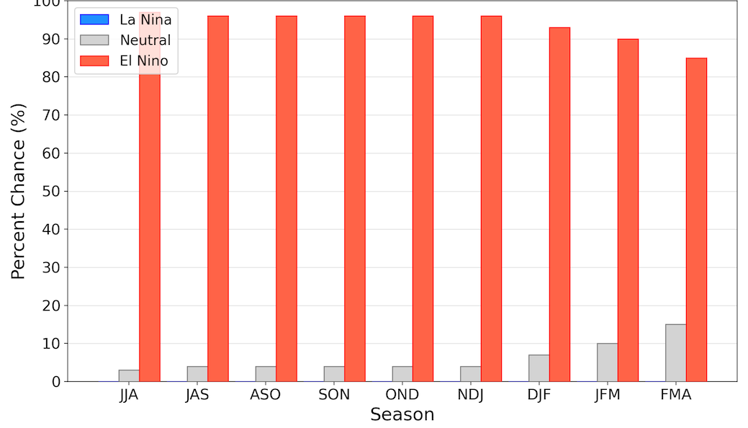
What do the global & regional Climate models could tell us! …
All models are saying Moderate to strong ENSO-El Niño
Both observations and model forecasts indicate the presence of mild warm SST anomalies in the Atlantic Ocean, and a positive Indian Ocean Dipole is predicted to develop in Aug-Oct, and continue during the boreal fall.

Slide 30
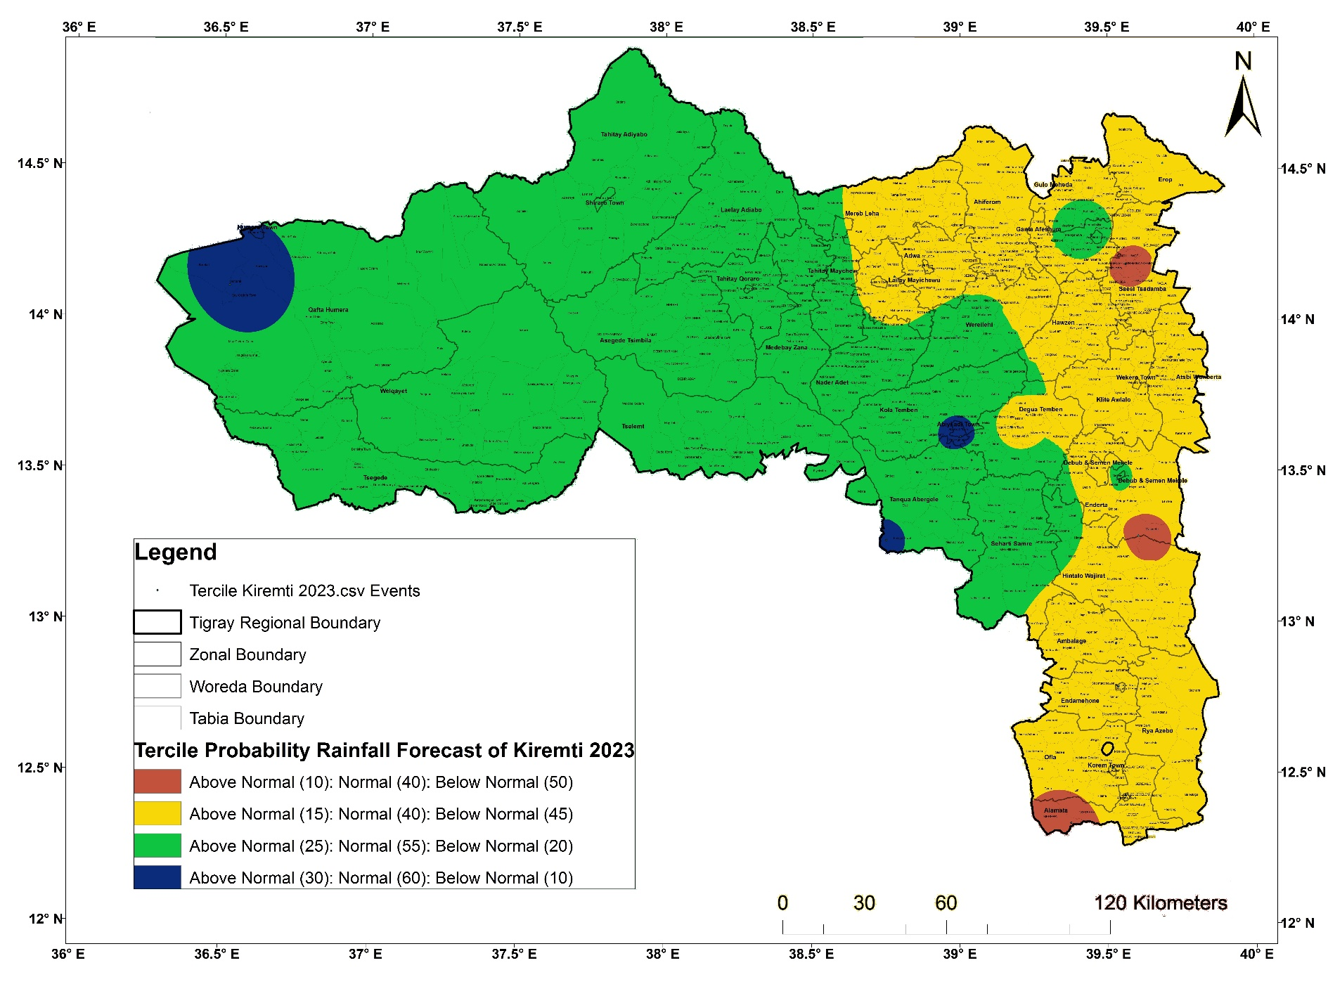
Tercile Probability of Kiremti-2023 rainfall outlook or forecast

Slide 31
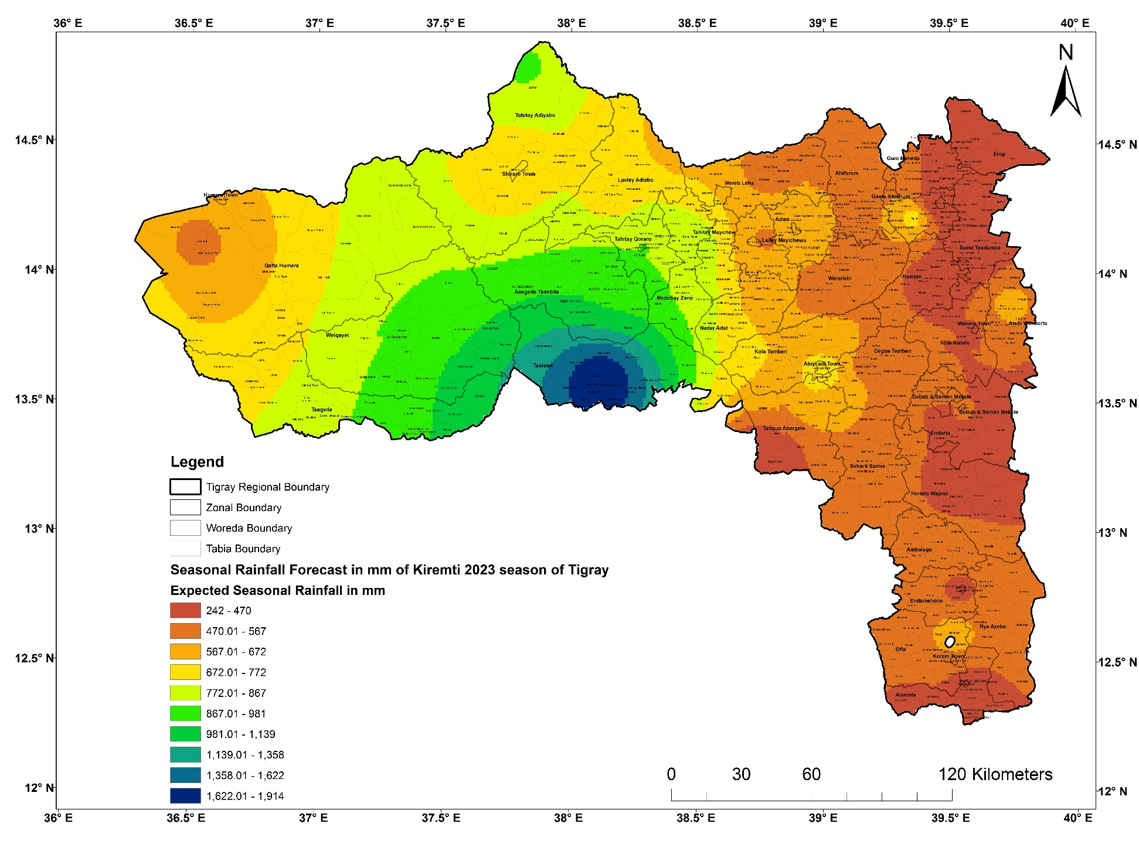
Kiremti-2023 Precipitation (mm) forecast of Tigray

Slide 32
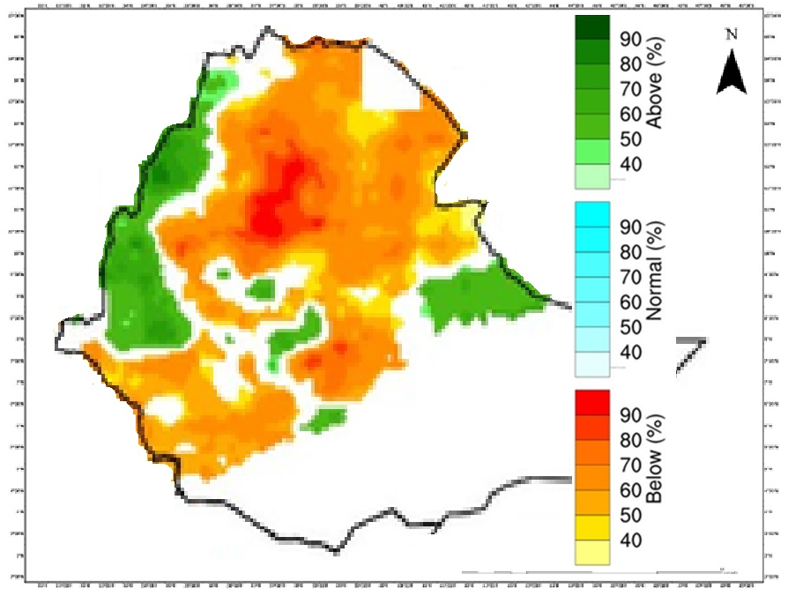
Expected Rainfall Probabilistic Monthly forecast of August 2023

Slide 33
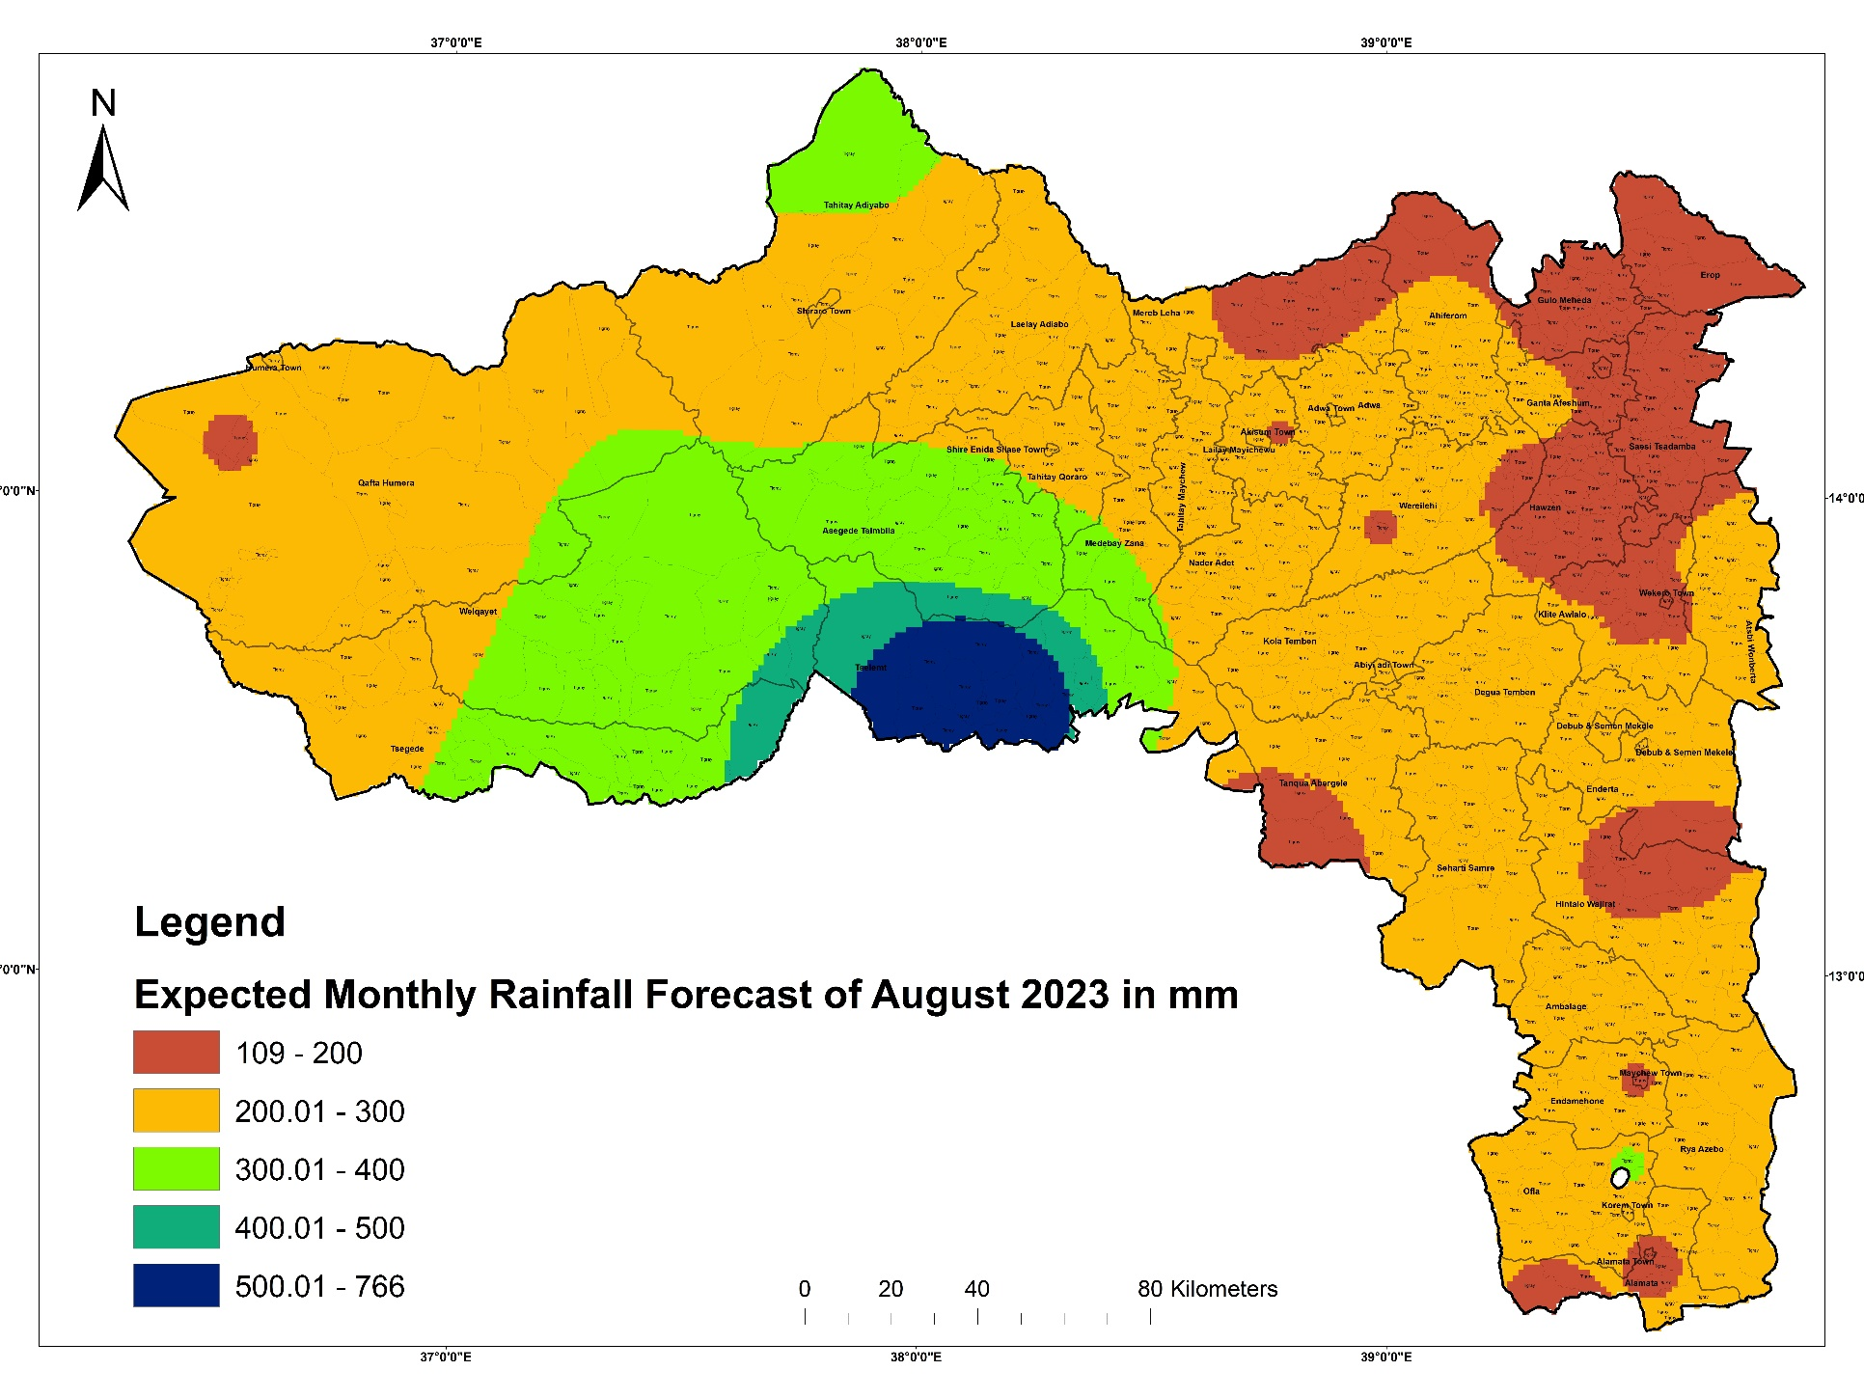
Expected Rainfall forecast of August-2023

Slide 34
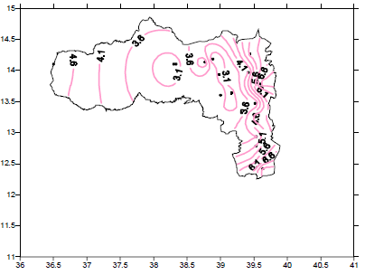
Expected maximum spell lengths for the month of August-2023
Most of the spell lengths are less than seven days all over Tigray

Slide 35
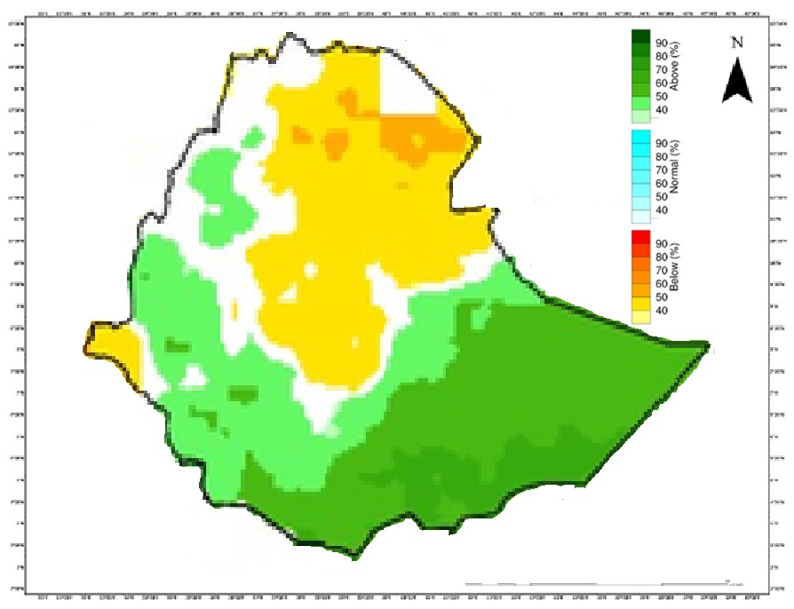
Expected Rainfall Probabilistic Monthly forecast of September 2023

Slide 36
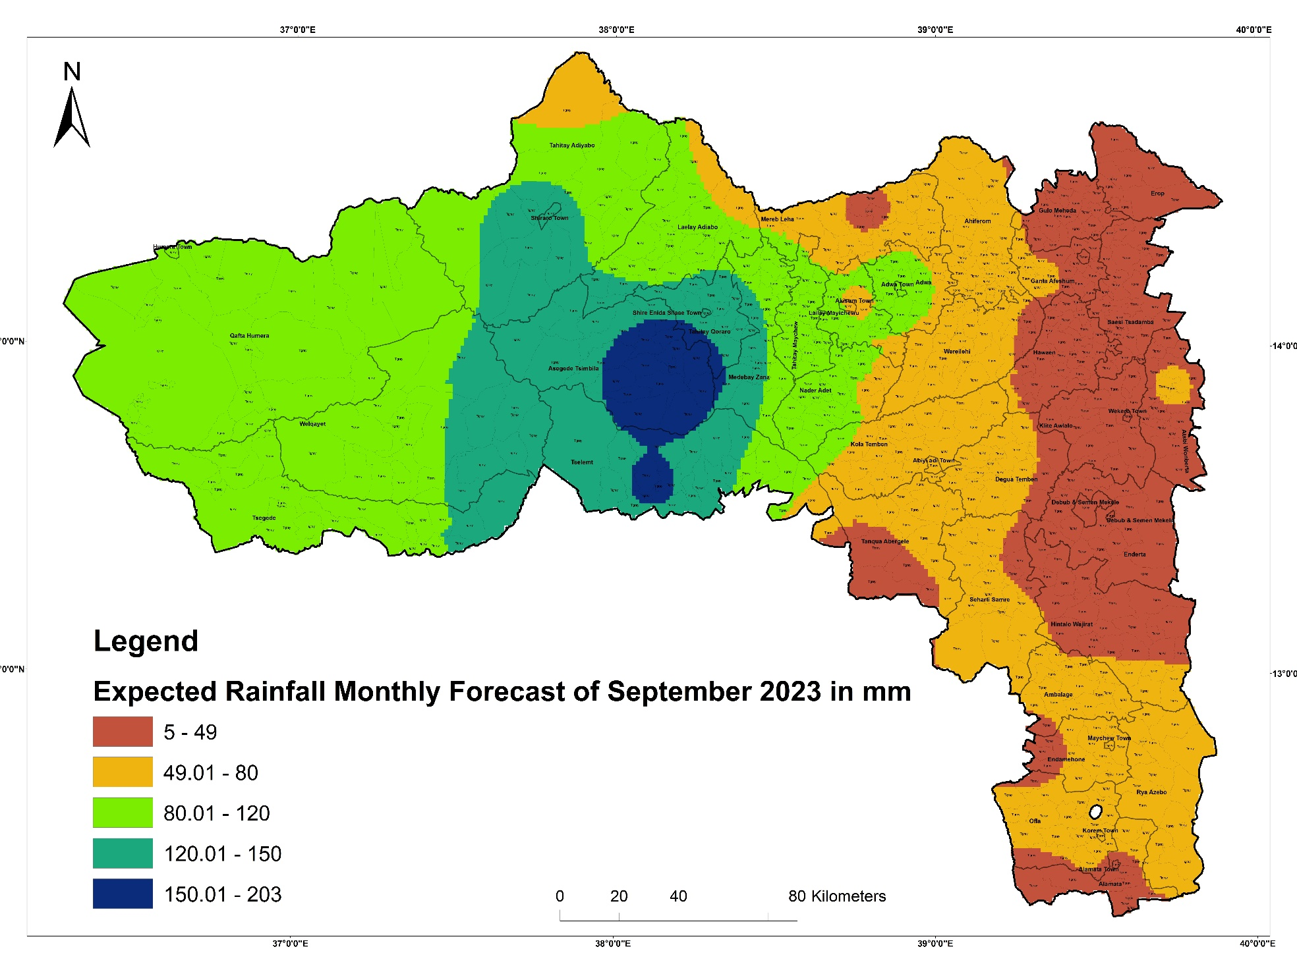
Expected Rainfall forecast of September-2023

Slide 37
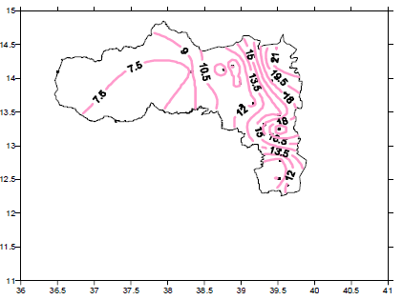
Expected maximum spell lengths for the month of September-2023
Decreases from east to central and west of Tigray; and
East and south parts relatively have larger spell length than central and west parts.

Slide 38
Map that depicted the Expected K’remti seasonal rainfall cessation of Tigray

Slide 39
The variability of kiremti cessation of Tigray
The variability is about two weeks in the west, east and some part of southern Zones; and
The variability is about three weeks in the central and far south part of Tigray

Slide 40
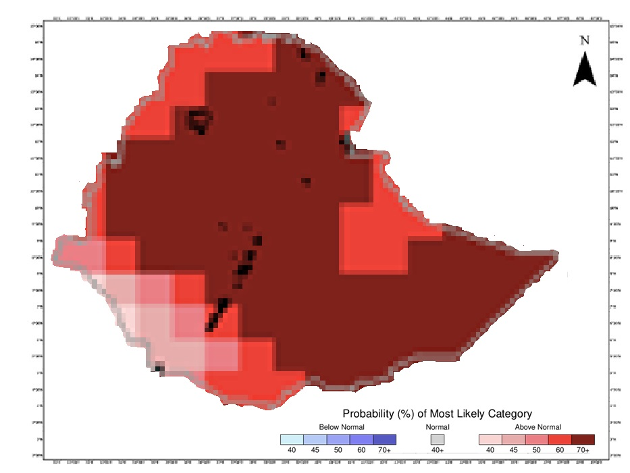
Expected Temperature Probabilistic August and September forecast of 2023

Slide 41
What can we tell about the desert outbreak?

Slide 42
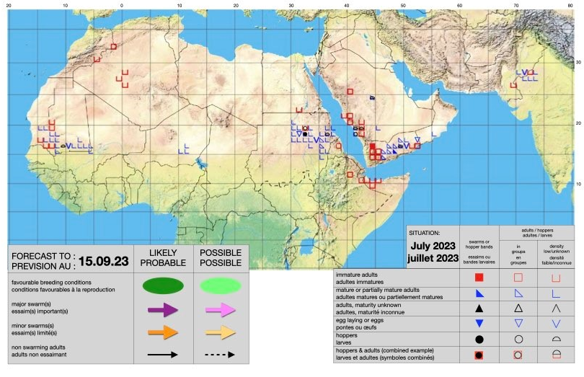

Slide 43
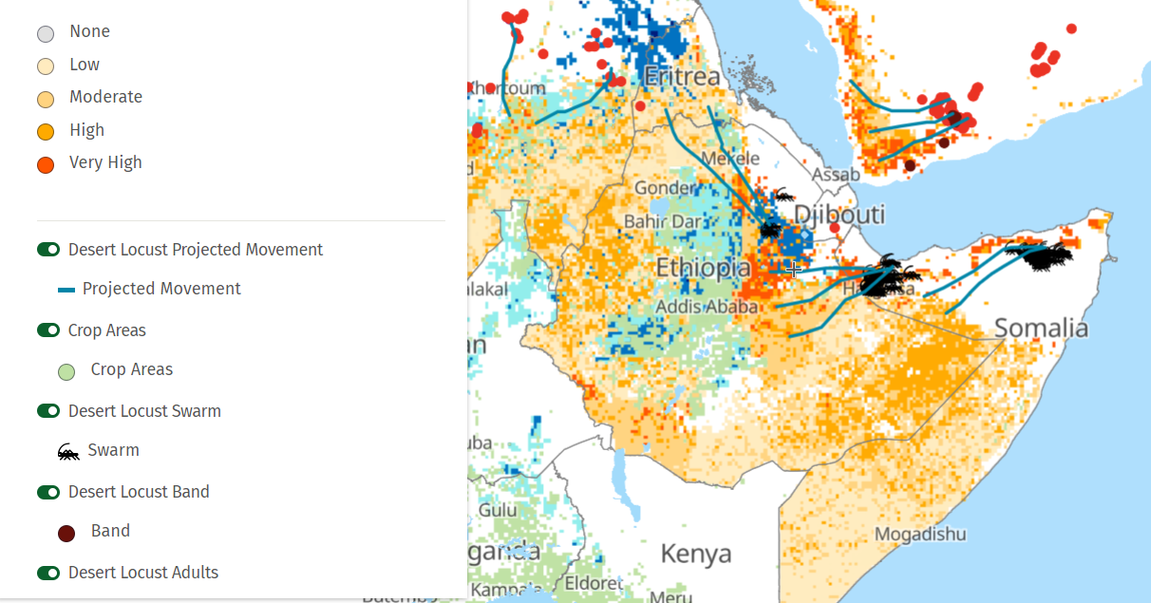

Slide 44
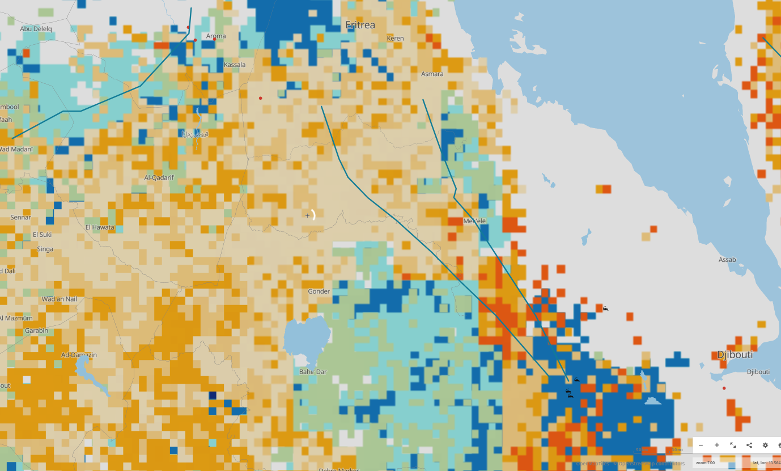
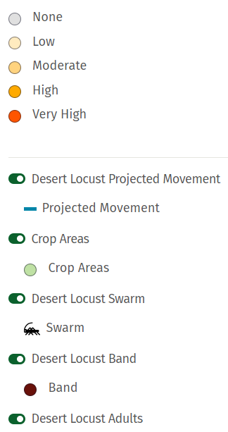

Slide 45
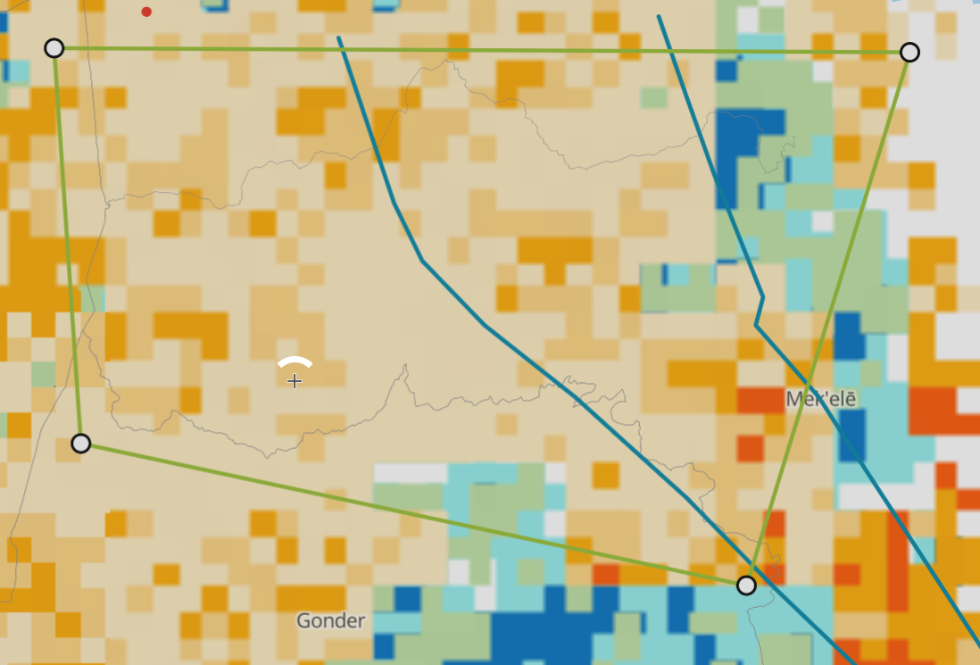

Slide 46
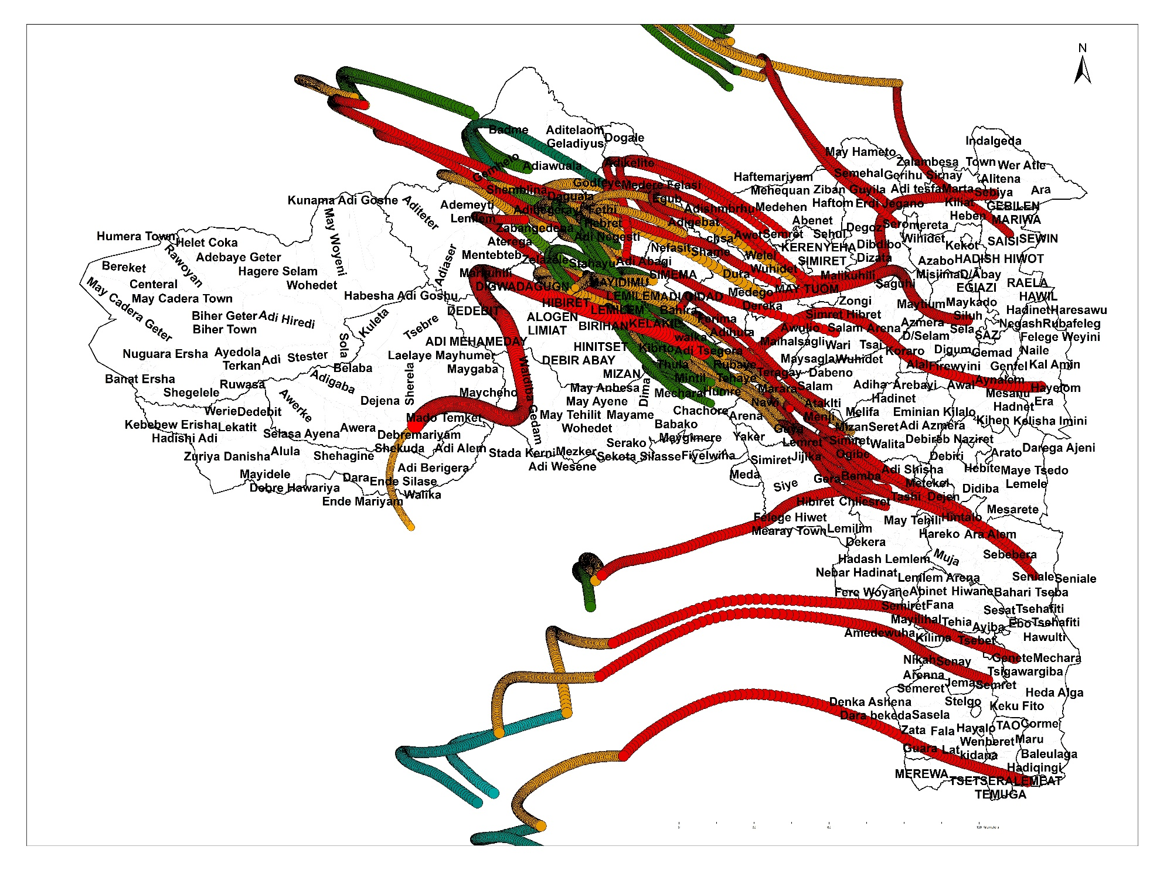
Expected Desert Locust Swarm coverage and movement

Slide 47
In Conclusion, …
Early cession of rainfall starting the end of August is expected across much parts of Eastern and Southeastern, and Southern Zones in the region.
Rainfall is expected to resume again starting first ten days of October to the mid of November which is bad to crops which are at their harvesting stages.
There is currently favorable conditions for locust outbreak across Recession and breeding areas and meteorological variables (Easterly winds, Soil moisture, Wind and Vegetation coverage)

Slide 48
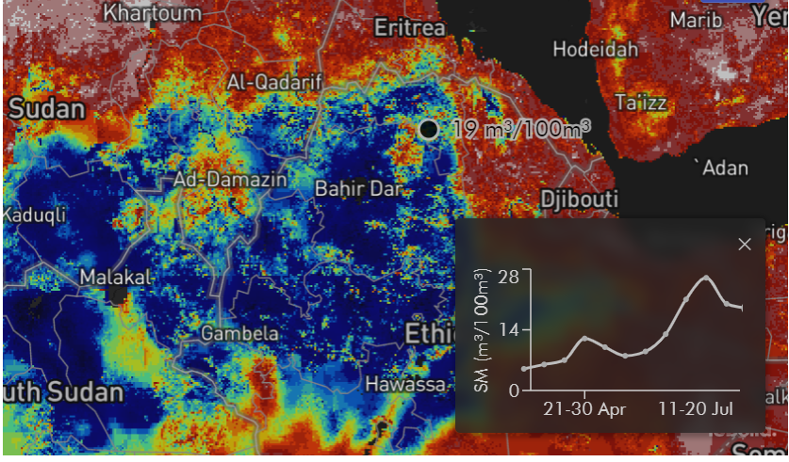
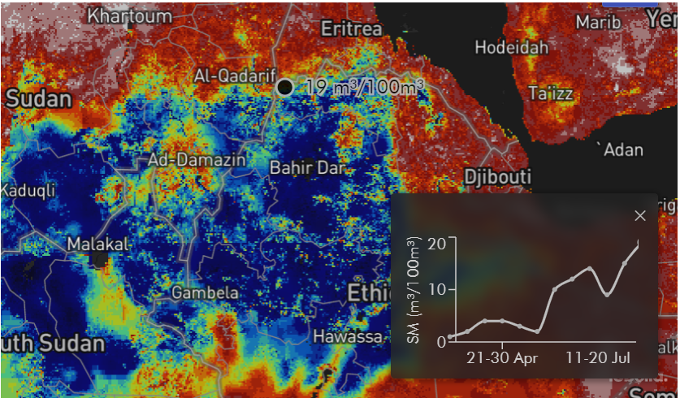

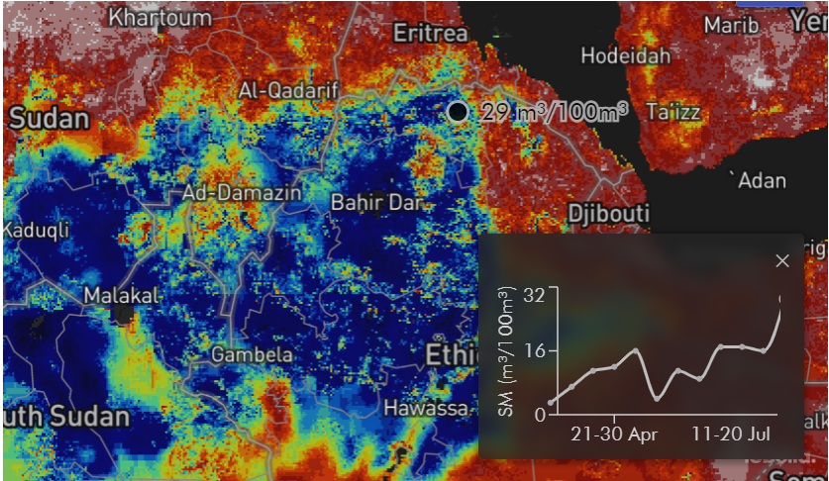
Soil Moisture for Locust Breeding scenarios are till Favorable

Slide 49
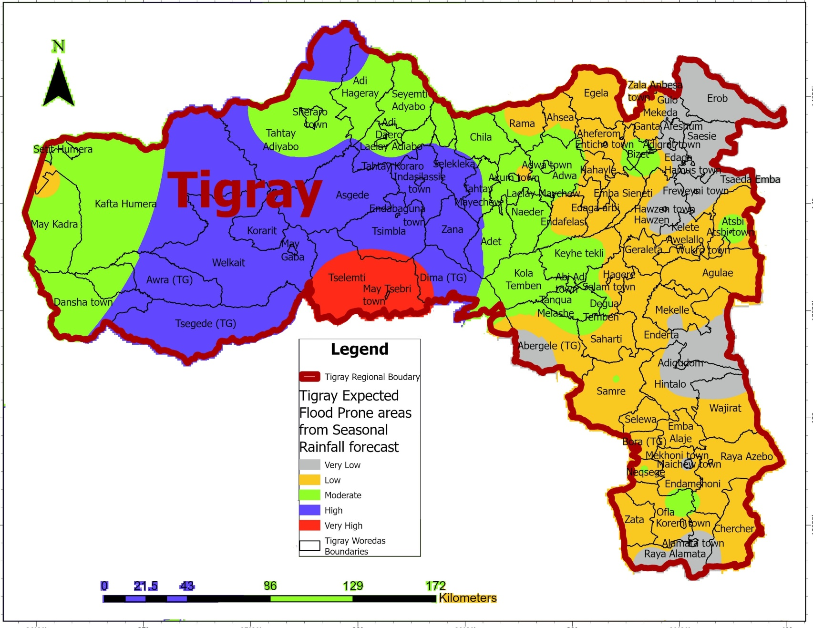
Please, let’s don’t make it suffered or disappointed the Science! How many lives do we have lost due to flood? Shire, Abi-Adi,…
Are we responding to warning or to the disaster?
Anyway…let’s go!

Slide 50
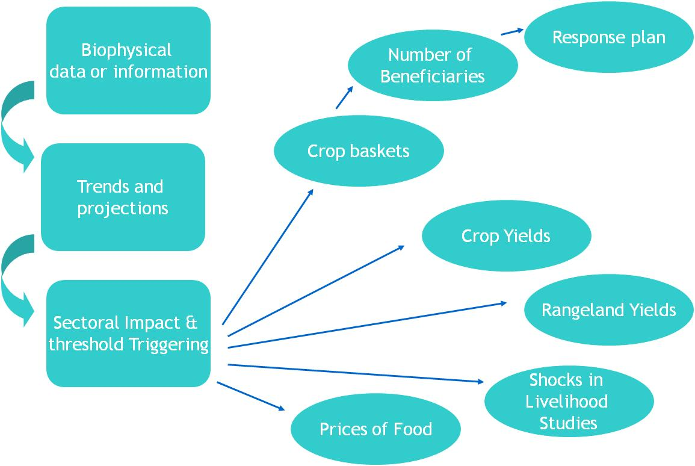
But still I am trying to figured out… Framework for integrating climate risks into emergency response plan
<number>

Slide 51
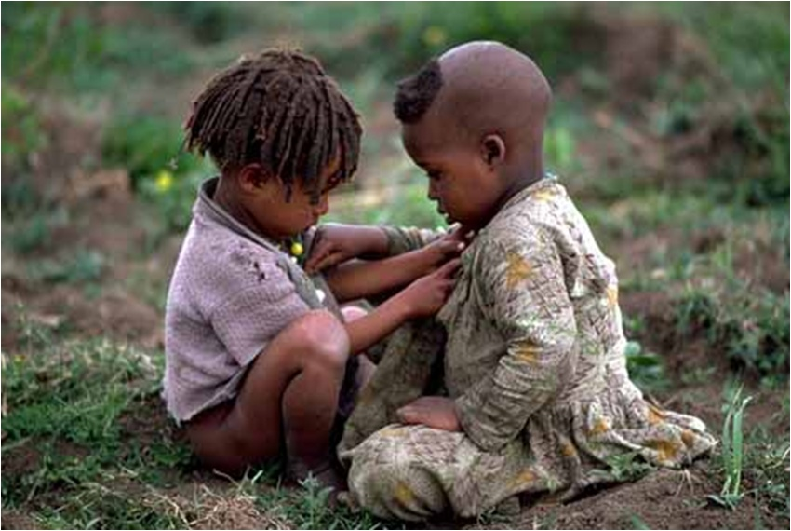
Knowing is not enough; we must apply.Willing is not enough; we must do.

Slide 52
Situation of sporadic and migratory pest control
And proposed emergency plan of plant protection and quarantine
Augest 4 /2023

Slide 53
1.Back ground information
Due to the war erupted, on November 4/2020 all necessary inputs for plant protection and quarantine like agro-chemicals, spray machines, personal protective equipment (PPE), stores, lab equipment, and other materials have been destroyed, looted, and burnt.
And due to the siege, supplies of inputs became very limited and farmers are not able to access the described inputs above.

Slide 54
Contin….
Farmers are suffering from the war in multidimensional ways
  Directly their properties was looted,
  Blocked to market access of inputs
  Instability & displacement of farmers did not allow to proper management of their land.
That means farmers were forced to plant their farmland in the first ploughing and or second ploughing, leads to create conducive environment to pest infestation.
As a result weeds, pests, and disease significantly contributed to yield reduction.

Slide 55
Contin….
The war also affect the whole regulation system of plant protection and quarantine,
  Weak quarantine system (because of the un regulated trade)
  Limited capacity of regulatory body (b/s of the shortage of bedget for M&E,Fuel ,Car etc

Slide 56
2. Objective
General objective
To enhance the pest management system and capacity of the region and then to play a role in the food security enhancement.
SPESIFIC OBJECTIVES
  To capacitate plant protection experts on pest survey, diagnosis and control.
  To equip pesticide sprayers and safety materials.
  To create a community based pest management system by provision of training to community facilitators at kebelle level

Slide 57
4. Current situation and achievements so far on controlling the Army worms , Desert and Tree Locust
4.1 Control operation of African army worm(AAW)
  Right after the presence of AAW was reported from R/Azobo on may 28/2023
  The BoANR was Continuously Alerting the community
, the best out let was using media
    All zones and wereda experts, local administrators and farmers were aware to assess their fields continuously and report to the region by saying yes or no.
  Strengthening and re establishing of pest control task forces at all level
  Re-allocate resources (agro-chemicals, sprayers, Personal protective equipment's and some detergents) to hot spot area

Slide 58
Monitoring the Control operation of AAW
Area coverage of the AAW by werda and zones
  It cavers 5 zones,31 weredas and 126 kebelles of the Tigray
  Area planted in 31 weredas only 527,885 hectare
  Total area surveyed 520,285.8 hectare (61,496 ha done by Experts) the remaining is done by farmers,
  Area infested by the AAW 28,041.3 ha in crop land and 1611.5 hactare in range land total 29,652.8ha
  Area controlled 25,649 ha which (86.5 %) of wich18,981 ha by chemical and 6669 ha by cultural methods
  Chemical used:- 7444.5 liters for AAW ony
  Still on going

Slide 59
4.2 Monitoring Control operation of Fall army worm(FAW)
FAW has similarly spreading in all farms planted by Sorghum and Maize,
Area covered by FAW :- 5 zones,9 weredas and 54 kebelles
Area planted on 9 wedas only 39,831.5 ha
Arae surveyed 26,058
Area infested by FAW:-10,594.8ha
Area controlled:- 3,692.25ha (by 4758.1ha by chemical and 8450.35 by cultural practice
Chemical used :- 2,274.5 liters
  Total chemical used for AAW and FAW is 9,719 liters of which 2,700 liters is applied farmers by farmers privately
  irrigation and Meher season cropping also helps it to built its population
  Other materials used to control the AAW and FAW was 610 knapsack,280 ULV sprayers,100 PPE and 100 liters of soap.

Slide 60
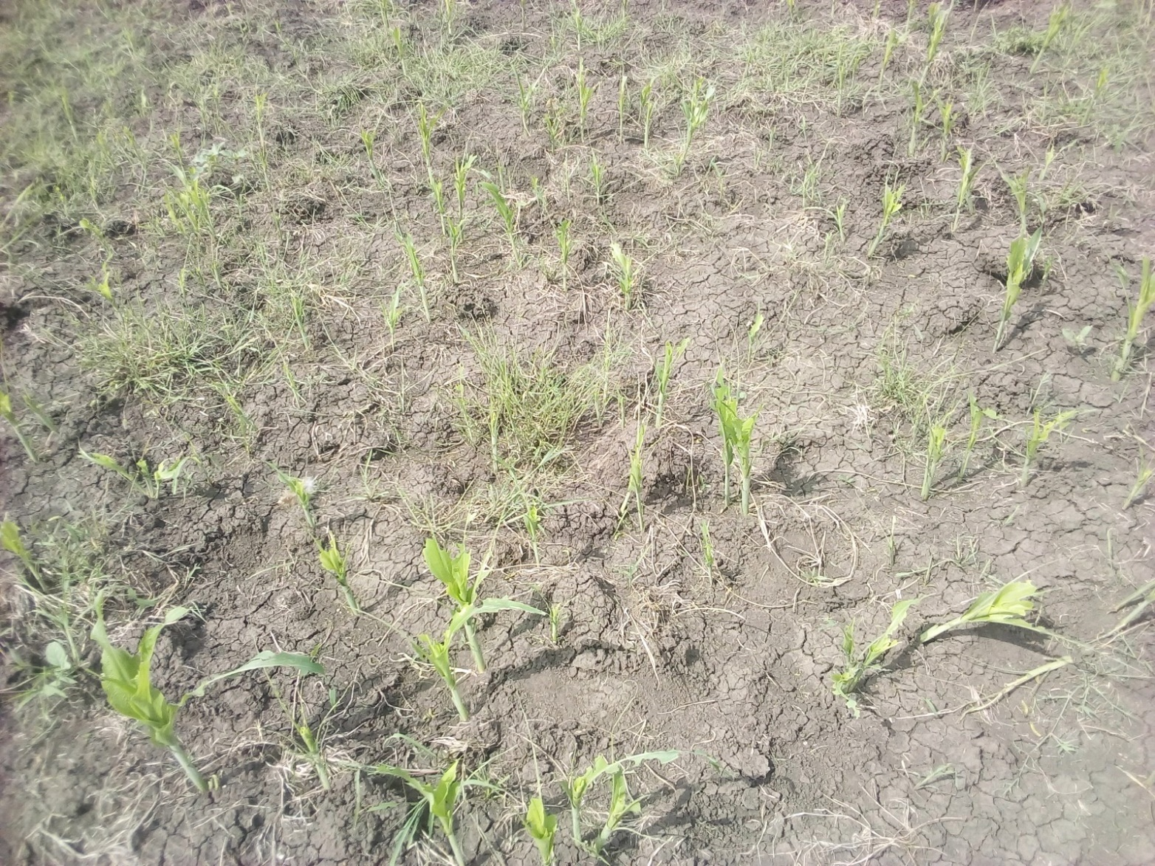
Raya Azebo Hawelti kebelle

Slide 61
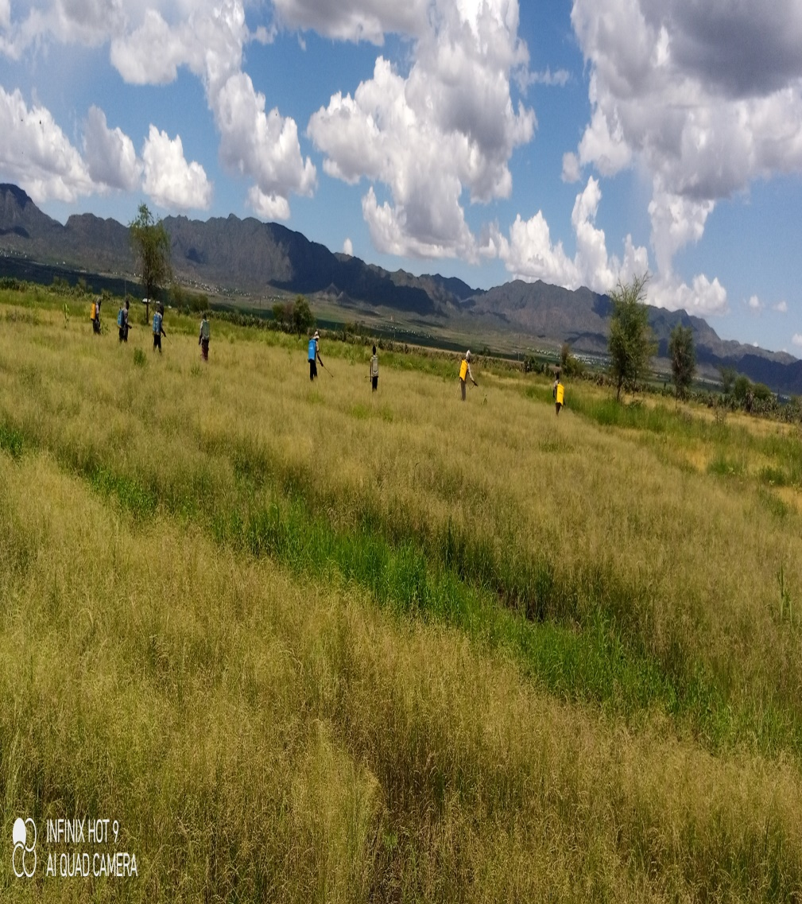
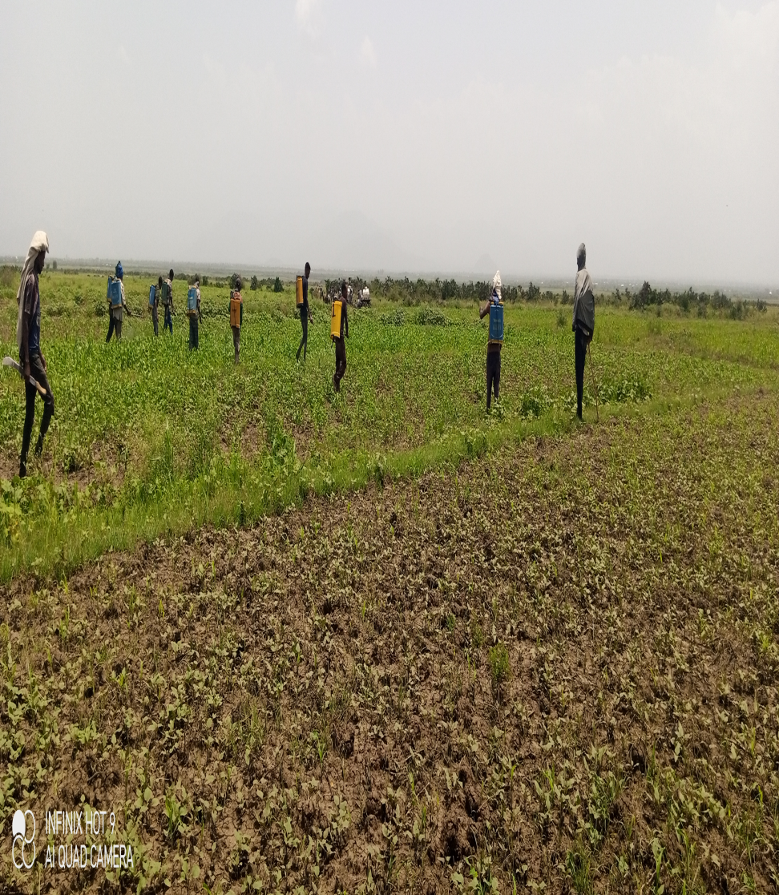
Control strategy practiced --Chemical spray

Slide 62
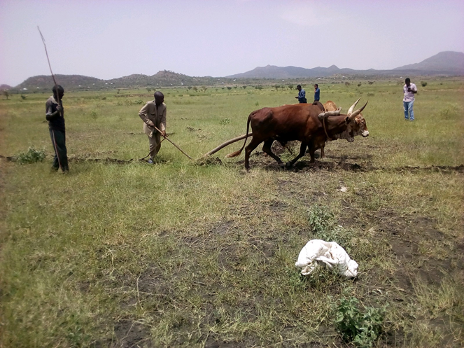
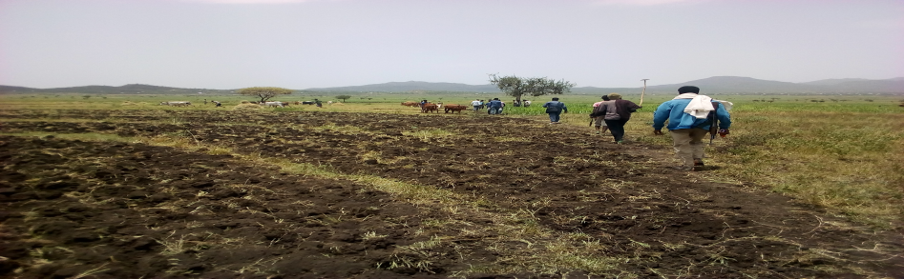
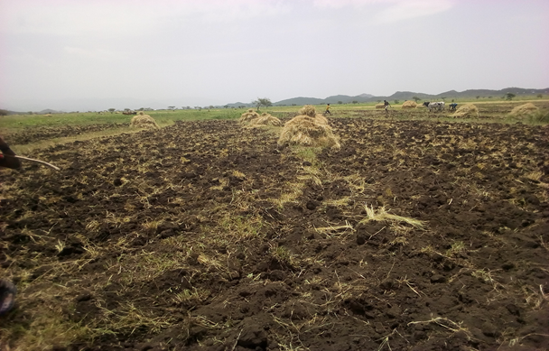
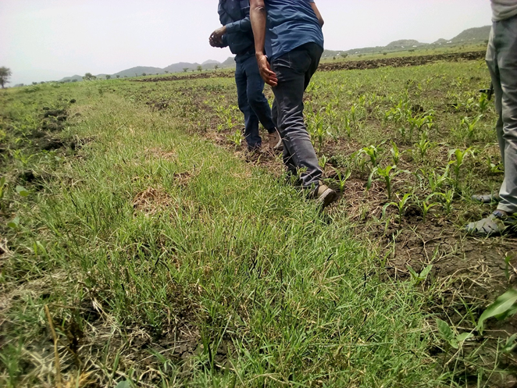
Control strategy practiced -Cultural practice
Plouphing and harvesting matured crops
Removing grasses

Slide 63
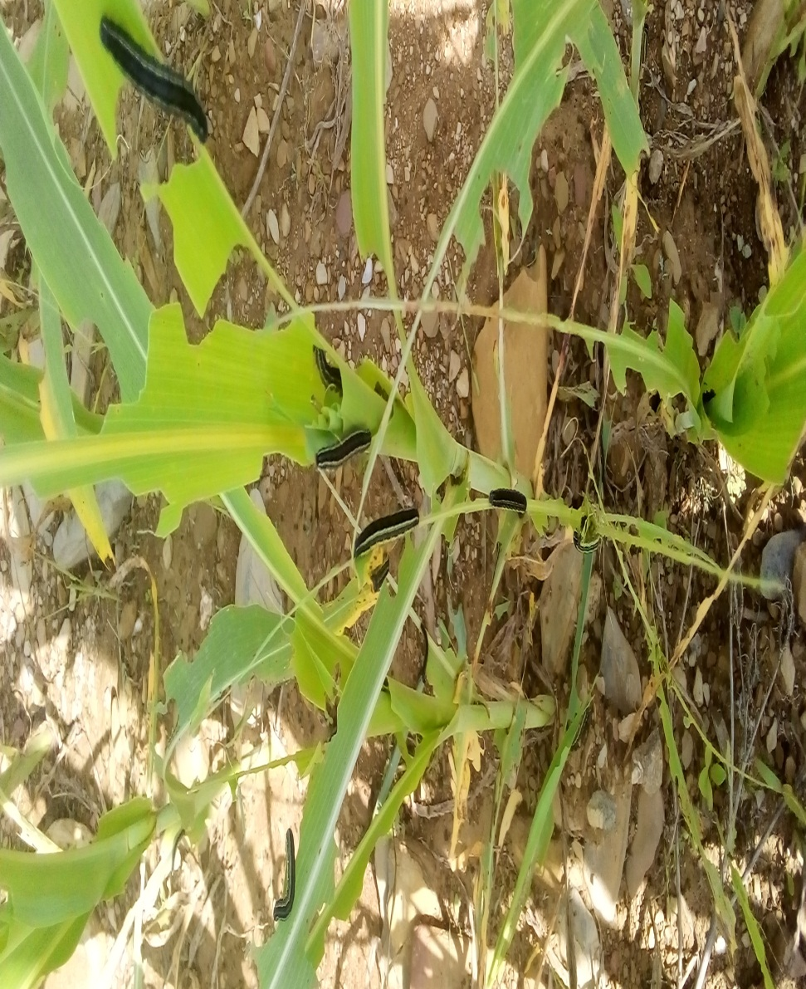
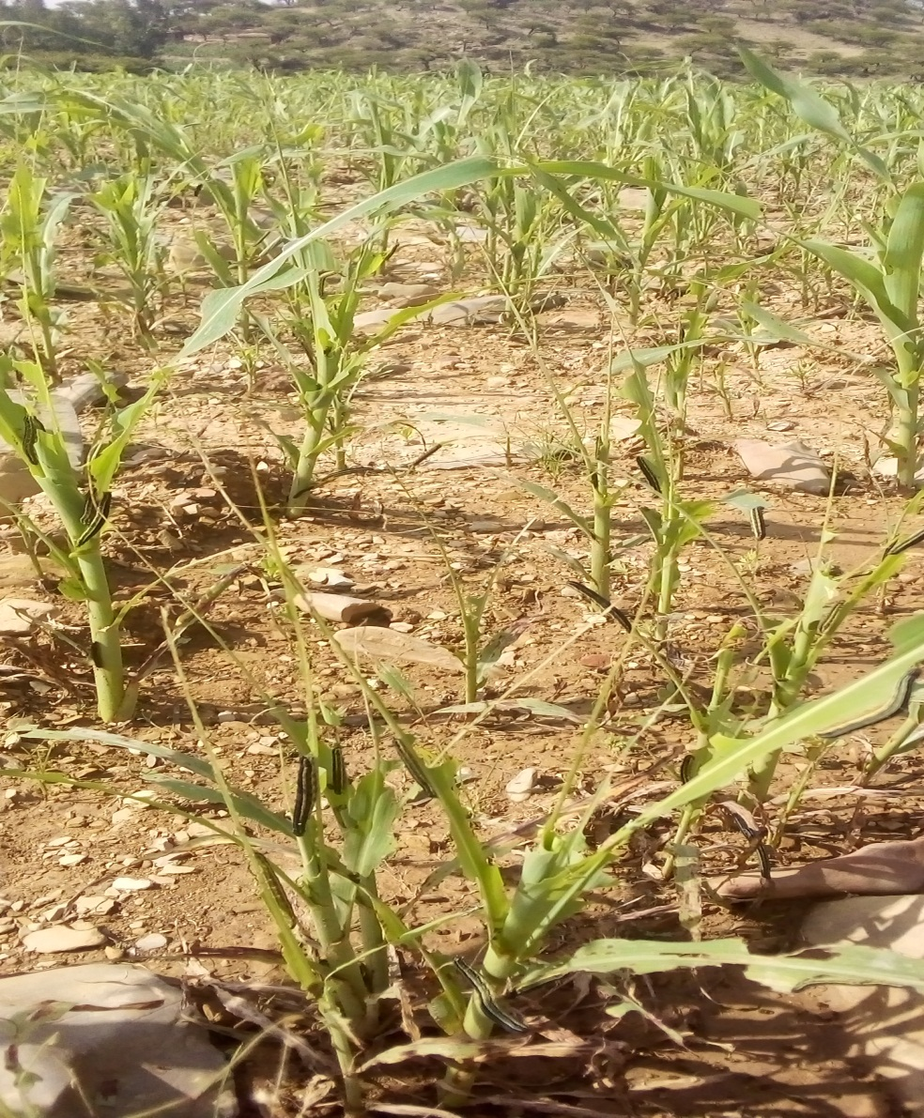
Infestation and damaging of Armyworm in wereda Enbasneyti kebelle A/hidem

Slide 64
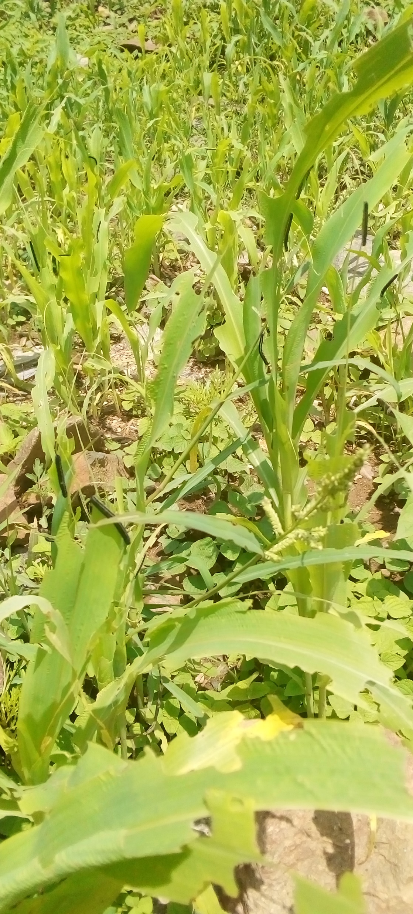
Infestation and damaging of Armyworm in wereda E/tsahima kebelle tsaie

Slide 65
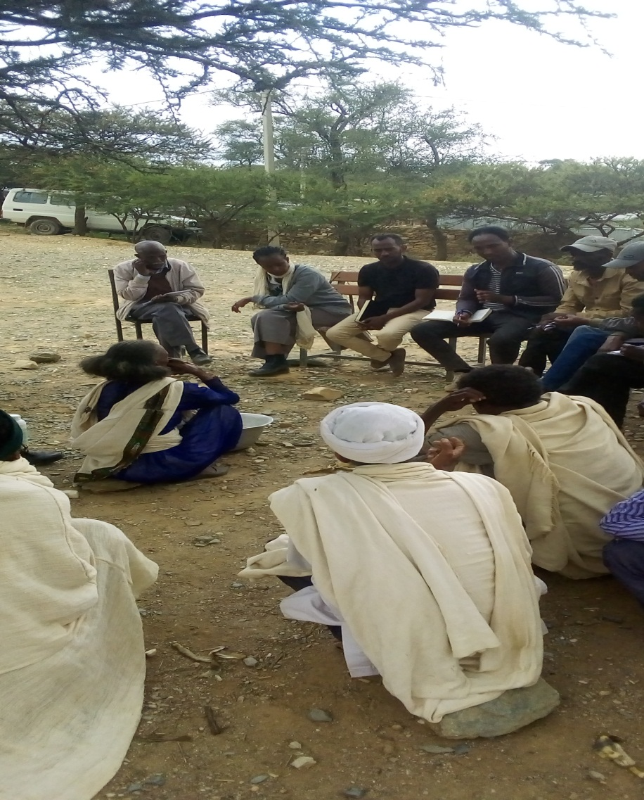
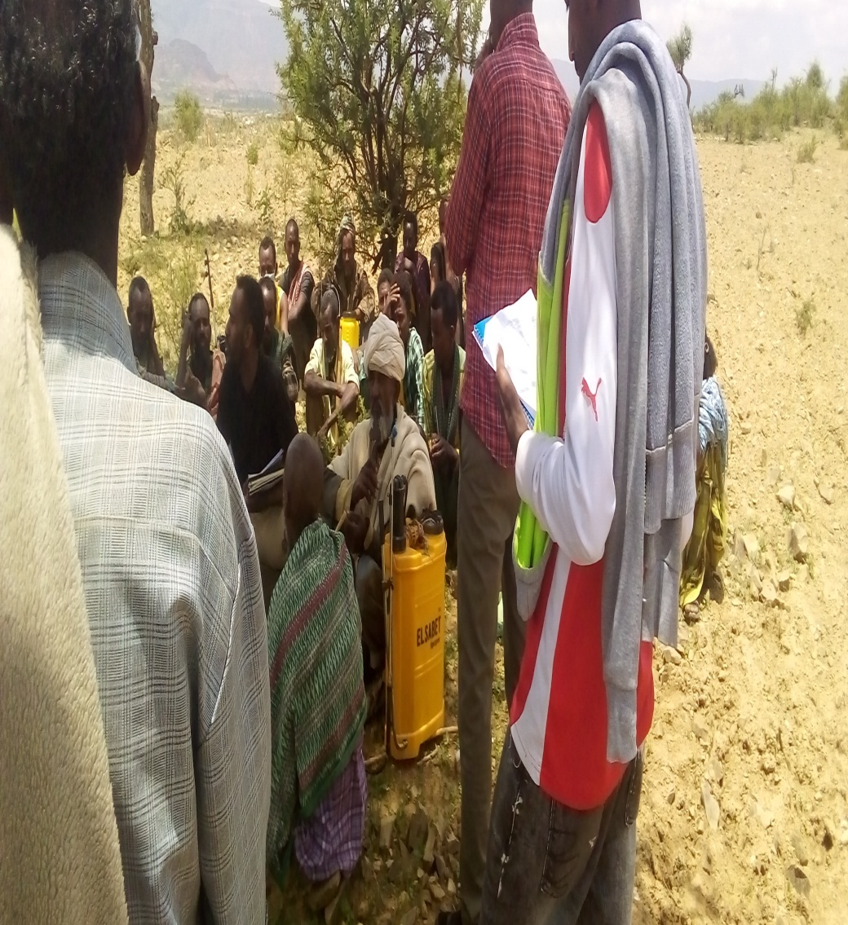
DISCUSSION IN K/TEKLI AND E/TSAHIMA WEREDAS

Slide 66
4.3 Tree Locust infestation and control
The 3rd most threat for the region is swarms of Tree locust
  As we all know Tree locust was saw in north western zone on last April /2023 caused a serious damage on tree crops like Mango and forage trees in general.
  The coverage was on 5 weredas and 27 kebelles of (Asgede, T/Adyabo, L/Adyabo, M/Adyabo and Seyemti Adyabo),
  It caused serious damage 50–100% in average 75 % (Specially on trees landed on)

Slide 67
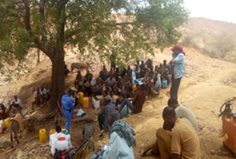
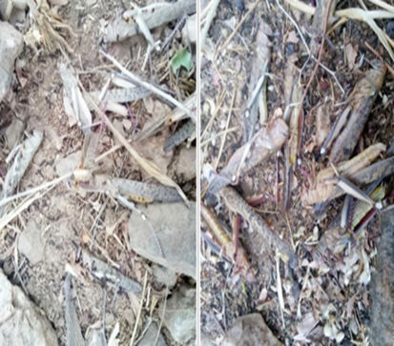
…. Locust infestation and control
  Action was taken to control the locust laid over 4500 big crop and forage trees (
  The BoANR supplied 800liters of fuel of which 2ooliteres of gasoil used to operate the motorized sprayers as a result it was managed and minimized its damage,

Slide 68

4.4 Desert Locust infestation and control
Starting from mid July Desert Locust is becoming serious issue

Slide 69
…. Desert Locust infestation and control
There are big swarms among Yalew and Megale wereda (Birma) in Afar regional state which is neighboring to R/chercher and R/Azebo.
And there are also another big swarms at kukeba near to Atsbi and Berahle areas
NOW they are flooding to Eastern, South Eastern, and Southern part of Tigray
Currently the DL is moving around
Sewhasaesie –Edaga Sewne stay for the last three days (1-3/8/2023)
Tsaeda Emba wereda- Sendeda,Tsenkanet,Agazi and Hadnet (3/8/2023)
Enderta –Derga ajen and chelokot (3-4/8/2023)
Tsirae wenberta (29-30/7/2023)
Atsbi-G/kidan,kalamin,Adibarka (28-30/7/2023)
Kilte Awlaelo- Felegemayat (29-30/7/2023)
Hawzen (29/7/2023)
And today at R/Azebo –Genete kebelle (3-4/8/2023)

Slide 70
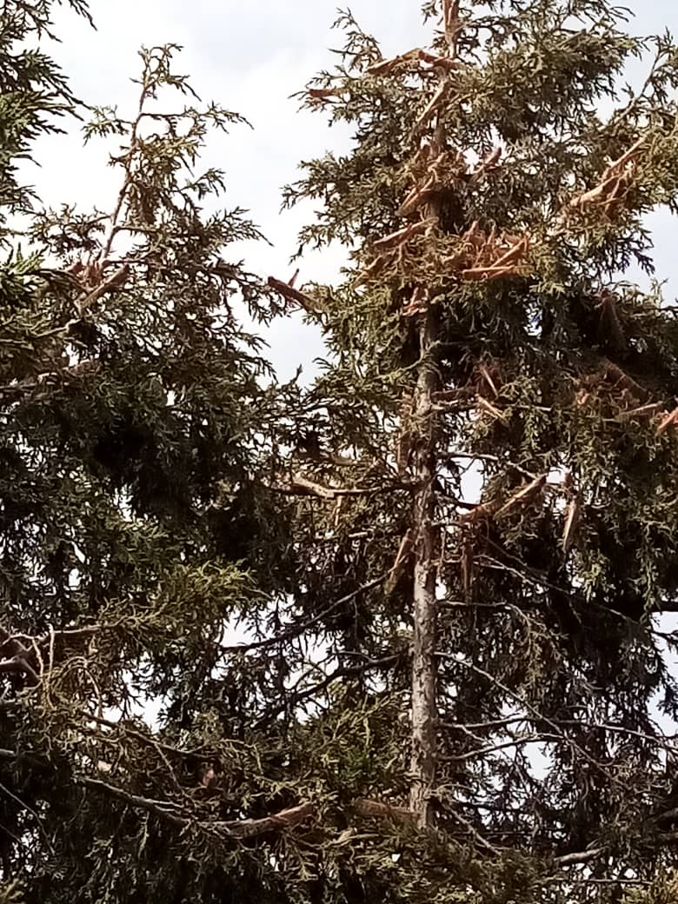
Desert Locust infestation in eastern zone Atsbi
(august 1-3/2023)

Slide 71
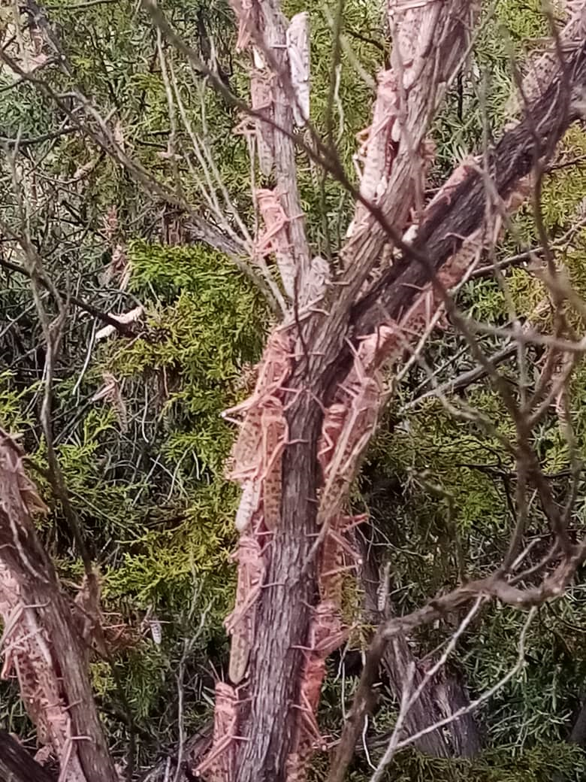
The situation on Desea forest

Slide 72
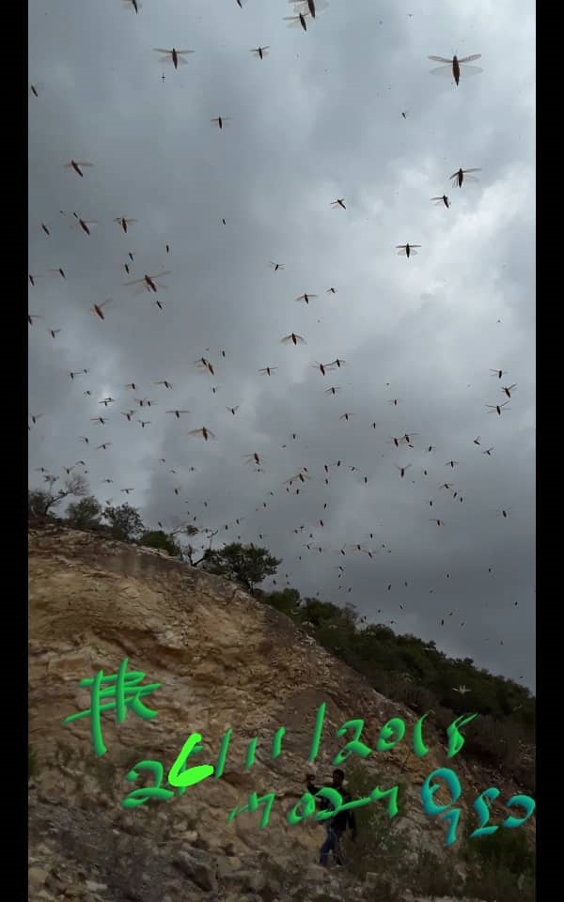
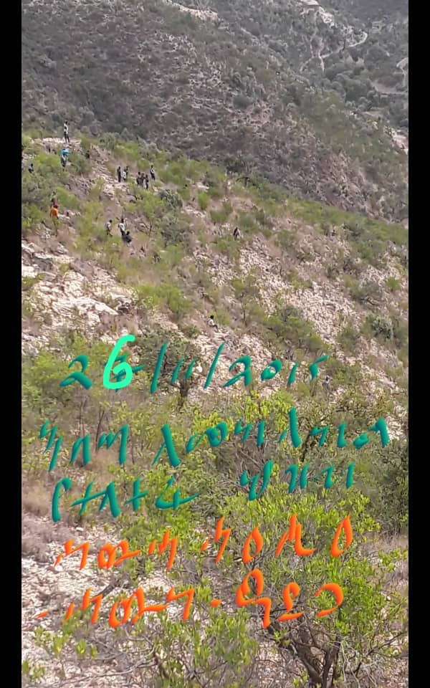
Swarms are moving from Afar to Tigray
Sewhasaesie(edega-sewne)
Sewhasaesie(edega-sewne)

Slide 73
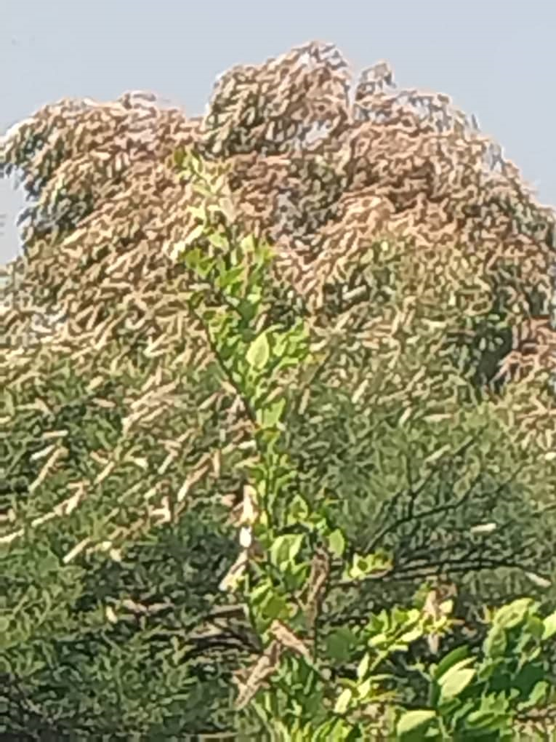
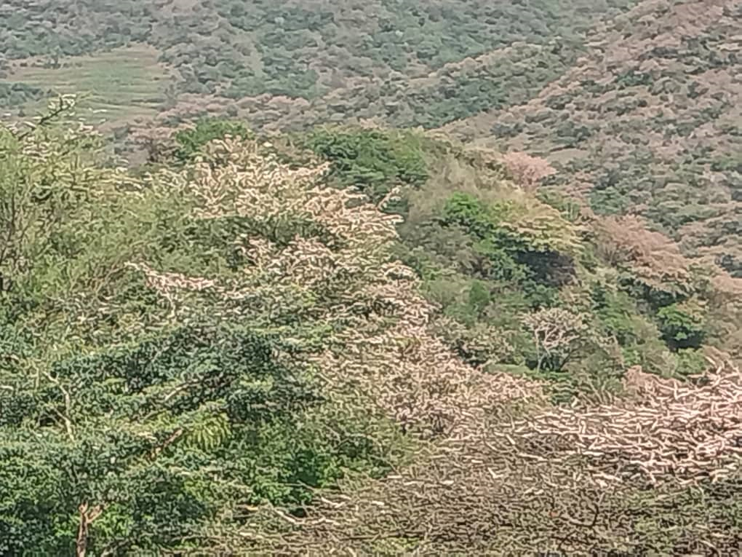
Neighboring region -Amhara
Amara –kalu wereda
Amara –kalu wereda

Slide 74
Swarms on going- that will invade Tigray soon

Slide 75
…. Desert Locust infestation and control
Needs huge resource to manage and ready all human and physical resources by training and availing resources on pest risk areas,
Other emerging new pests which needs resource to follow up and control
New insect pest partially identified as it is leaf beetle which attacks tree locally named Qawa in Ganta Afeshum, Enderta and Degua Temben
There is also new emerging pest in Bizet wereda it has a similarity with that of leaf beetle but a beet different

Slide 76
5.Activities done so far to control DL
5.1. Re-allocation of resource to hot spot area
S.N | ZONE | WEREDA | Different input distributed
 |  |  | Agro-chemical |  | knapsak | PPE
 |  |  | EC formulation | ULV formulation |  | tuta | facemask | glove | Botty | Eye pro
1 | south | Endamokoni | 1000 | 1200 |  | 20 | 20 | 20 | 20 | 20
 |  | R/azebo |  | 800 |  | 10 | 10 | 10 | 10 | 10
2 | eastern | S/saesie | 100 |  | 10
 |  | Tsaeda enba | 100 |  | 10
 |  | Atsbi | 100 |  | 10 | 10 | 10 | 10 | 10 | 10
 |  | Tsirae | 100 |  | 10 | 10 | 10 | 10 | 10 | 10
 |  | Hawzen | 100 |  | 10 | 10 | 10 | 10 | 10 | 10
 |  | K/Awlaelo | 100 |  | 10 | 10 | 10 | 10 | 10 | 10
3 | centeral | Axum | 500 |  |  | 10 | 10 | 10 | 10 | 10
 |  | Adwa | 420 |  |  | 10 | 10 | 10 | 10 | 10
 |  | K/temben | 420 |  |  | 10 | 10 | 10 | 10 | 10
total |  |  | 3100 | 2000 | 60 | 100 | 100 | 100 | 100 | 100

Slide 77
5.2.Re-establishing survey and control control
Establishment of 4 survey and control stations
The stations will have 20-30 man power from region, zone and wereda experts
Planed to supply all necessary logistics like
  Car mounted sprayrs,
  Hand held and knpsack sprayers ,
  Agro chemicals and
  Personal protective equipment's (PPE)

Slide 78
5.3.Identifay Logistics required
Budget support to purchase and distribute
  3,000 knapsack sprayers
  6,000personal protective equipment
  1,000 liters of liquid detergent
  1200 dry soap
  50,000 ULV battery(durata)
  6000 liters of Gasoil for the motorized sprayers
  50000 liters of fuel for vehicles
  And budget 20 million ETB for surveillance, monitoring and evolution (M&E ) to control the sporadic pests which are very challenging right now in the ground.

Slide 79
5.4. preparation of budget required
SN | List of activities | Unit | quantity | budget | remark
1 | Provision of training for zone & wered experts | No | 280 | 1,701,500
2 | Provision of training for plant doctors to re-establish the service of plant health clinic | No | 87 | 647,056
3 | Provision of training for sprayers (experts and community sprayers) to have a basic understanding of using &handling of pesticide | No | 1281 | 2,581,300 | 1220 community sprayers
4 | Traing for community facilitators on how to scout fields & communicate with developmental agents & wereda experts | No | 1220 | 673,910
5 | To conduct survey of both regular & sporadic pests | Time | 4 | 520,000
6 | Supply of materials to re-establish & equip the service of plant health clinic | No | diff | 737,760
7 | knapsack sprayers | No | 3,000 | 9,000,000

Slide 80
Contin….
SN | List of activities | Unit | quantity | budgets
8 | Personal protective equipment | No | 6,000 | 6,000,000
9 | Vehicle mounted sprayer maintenance | No |  | 2,000000
10 | Liquid detergent | Liter | 1,200 | 100,000
11 | ULV battery (durata) | No | 50,000 | 5,000,000
12 | Gasoil for the motorized sprayers | liters | 6000 | 420,000
13 | Fuel for vehicles | Barrel | 10 | 250,000
14 | Budget for Regular surveillance, survey and control teams to deploy,monitoring and evolution(M&E ) | Birr |  | 20,000,000
 |  |  |  | 49,631,526

Slide 81
Nutrition Cluster Update

Slide 82
Health Cluster Update

Slide 83
Cholera Emergency preparedness and response plan (EPRP), 2023

Slide 84
Cholera
Cholera is an acute diarrheal infection caused by vibrio cholera transmitted by ingestion of contaminated water and food.
Cholera is a fatal disease with 30-50% mortality without treatment
With Prompt Case management morality is less than 1% .
The disease has a very short incubation period starting from two hours to five days.
The disease has also fast transmission from person to person.

Slide 85
Risk factors
The destruction of the water scheme people are drinking water from untreated sources.
The health seeking behavior of the community severely diminished due the disruption of the health system
The WaSH practice diminished due to low accessibility, affordability of water treatment chemicals and shortage of water.
The health workforce not fully returned to their work station
Most health facilities of Tigray are still with critical shortage of medicine and which will be very difficult to manage cholera outbreaks if it happened .

Slide 86
Risk factors
Even after the peace deal large segment of the population of Tigray are still living in the IDP camps of
  Mekelle, Abiadi, Adwa, Shire, Hitsts Endabaguna, Sheraro Wukro, Adigrat, Maichew .
This huge displacement coupled with collapsed health system, poor WaSH practice, in adequacy of water and sanitation facilities, Food and shelter could increases the occurrence of cholera Outbreaks .
Taking in to account the above-mentioned risk factors, all partners and Stakeholders should promptly respond to the imminent public health threat bases on the developed EPRP.

Slide 87
Objective of the EPRP
The objective of this Plan is to reduce morbidity and mortality resulting from cholera epidemics/outbreaks by enhancing and revitalization cholera prevention and response pillars through timely preparedness for epidemics/outbreaks and early detection of outbreaks.

Slide 88
Objective
Specific Objectives
Improve coordination for cholera preparedness and response interventions.
Intensify cholera surveillance
Proper case-management and infection control and prevention during cholera outbreak response.
Enhance hygiene practice and environmental health procedures in response to outbreaks.
Improve water quality to prevent and control the outbreak
Enhance risk communication and health education in communities to prevent and control outbreaks of Cholera.

Slide 89
Cholera Situation in Ethiopia
According to EPHI ,As of 01 August 2023, cumulative of 16,842 cholera cases (cAR =104.5/100,000 Population) and 229 deaths (CFR = 1.4%) were reported nationally.
Since the 27 July 2023, 496 newly reported cases (170 new cases and 326 late reported cases) and 5 new deaths reported since 27 July 2023.
As of 02 August 2023, a total of 130 Woredas were affected from four regions (49 Woredas of Oromia Region, 40 Woredas of SNNP Region, 6 Woredas of Somali Region, 17 Woredas of Sidama Region and 18 of Amhara Region) were affected since 27 August 2022.

Slide 90
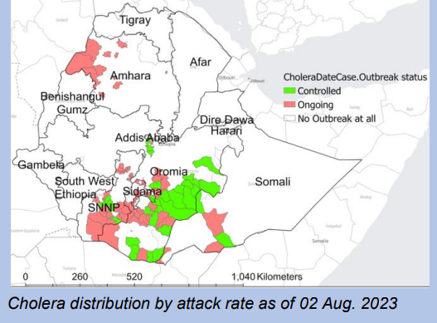
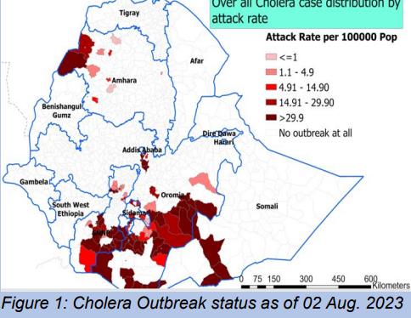
Cholera Situation in Ethiopia

Slide 91
Cholera hotspot assessment result
Bacteriological test
23 (32.8%) water samples were found positive for fecal coliform/contamination.
Samples were collected from different sources (Reservoir, Spring, Household, Water track, Roto & Hydrant).
69 water samples from different sources were tested for FRC.
58 (84%) of the water sample collected from different sources found with FRC bellow the standard(< 0.2).
Zones | #of woredas | # of Holy water | # of Idps
Mekelle | 3 | 5 | 0
East | 2 | 1 | 8
Central | 5 | 5 | 18
South | 1 | 0 | 2
Southeast | 4 | 3 | 0
North west | 10 | - | 7
Total | 25 | 14 | 35

Slide 92
Budget required for cholera EPRP
Summary of proposed budget for cholera preparedness and response
S. No | Pillars for cholera prevention | Proposed budget in ETB | Source
1 | Coordination | 6,117,000 | From all partners
 | Surveillance | 12,655,300 | From all partners
2 | RCCE | 17,562,760 | From all partners
3 | WASH | 86,781,600.00 | From all partners
4 | Case management | 98,761,005
 | Total | 221,877,665.00

Slide 93
Major challenges
Large number of IDPs.
Large number of holy water users
Damaged water sources
Damaged health facilities
Shortage of supplies for cholera management( even ORS)
Poor collaboration of sectors and partners
Shortage of ambulance for referral of critical cases
No budget allocated for cholera management

Slide 94

EWARS-Report Completeness
In this week the Data collected from 205 of the health facilities out of the 270 total facilities (excluding health posts) as a region
Hence the report completeness become 76% which is below the national standard
Zone | HFs
 | Expected | Reported | Percent
South | 38 | 19 | 50
Southast | 28 | 28 | 100
Mekelle | 16 | 16 | 100
East | 47 | 38 | 81
Central | 71 | 69 | 97
N/Western | 44 | 35 | 80
West | 26 | 0 | 0
Total | 270 | 205 | 76
Notes:
<number>

Slide 95
Top five diseases
Demanding special intervention to apply on malaria
ARTI alarming and need an urgent initiation of COVID-19 response and strengthen SARI surveillance

Slide 96
Major outbreaks
Malaria
In Week 29
Malaria Cases = 7,419
Malaria Death = 0
Three admission were from St. Merry hosp.

Slide 97
Major outbreaks
2. Measles
Trend of confirmed measles cases per week notification, South and South-east zone Tigray, Epi-week 15-29, 2023
About 36% (22/61) cases were imported cases
Currently no imported cases reported
No case reported since week 29

Slide 98
Spatial distribution of measles in southern zone Tigray, Epi-week 15-29, 2023
Age | # of cases | %
< 1 year | 15 | 25
1 – 5 years | 32 | 52
> 5 years | 14 | 23
Total | 61 | 100

Slide 99
Major outbreaks
Additional reports of suspected measles from other woredas, July, 2023
S/N | Woreda | # of suspected cases | Sample sent | Result
1 | Hawzen | 7 | 4 | 2 positive
2 | Adi-gudom | 2 | 0 | --
3 | Asgede | 13 | 5 | 3 Negative
5 | Adi-haki | 7 | 0 | --
6 | Shire | 2 | 0 | --
7 | Hintalo | 6 | 0 | --
8 | Axum Town | 1 | 0 | --
9 | Hawelti | 1 | 1 | + ve for Rubella
10 | Hahyle | 1 | 1 | Negative
11 | Abi-adi town | 1 | 0 | --
12 | Karl Lemlem hospital | 1 | 0 | --
TOTAL |  | 42 | 11

Slide 100
Major outbreaks
3. Pertussis cases update
Reporting capacity improves from 3 woreda to 16 woreda
Report on week 28 = 23
Report on week 29 = 35

Slide 101
4. Zoonosis
Distribution of Anthrax and Rabies diseases by Zone from EPI week 1- 29, 2023
S/N | Zone | Anthrax |  | Dog bite
 |  | Cases | Death | Cases | Death
01 | Centeral | 383 | 1 | 180 | 1
02 | East | 5 | 0 | 82 | 0
03 | Mekelle | 1 | 0 | 234 | 0
04 | N.west | 33 | 1 | 77 | 7
05 | South | 33 | 2 | 66 | 1
06 | S.east | 171 | 0 | 25 | 1
07 | West | 0 | 0 | 0 | 0
Total |  | 626 | 4 | 664 | 10

Slide 102
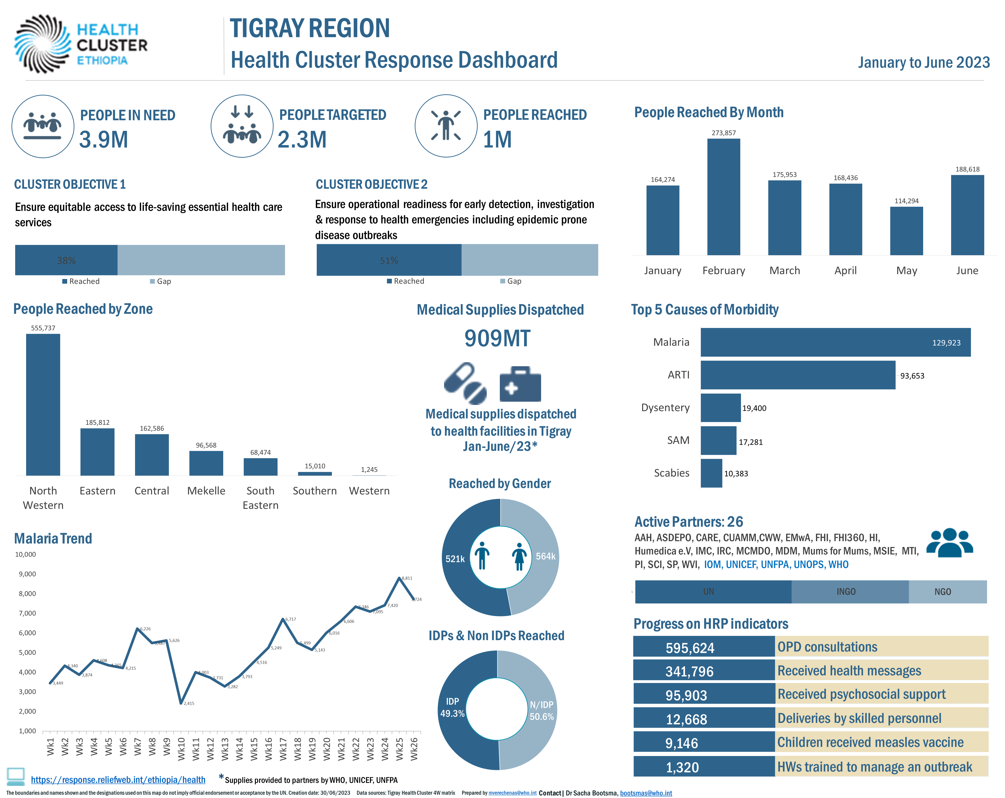
EWARS and EHS

Slide 103
Preparedness and response activities
Cholera preparedness and response plan developed and shared with partners
Partner mapping for cholera response developed and shared with partners
WHO allocated 5.2 million for cholera EPRP based on 4 pillars
RHB wrote Cholera Alert letter and disseminated to woredas and HFs
Cholera workshop conducted and TOR developed and shared to partners and Bureau
Polio OBRA conducted by TRHB & WHO-Afro in 6 woredas and 18 PHFs, and one IDP/traditional healers & HP from each woreda
HIV/AIDS training given for 52 HCWs from 7 Woredas/sub cities and 13 HFs by ICAP-E
Data management training given to 30 participants (Mekelle & TRHB PHEM officers by EPHI-PHEOC)

Slide 104
Challenges
No recording and Reporting materials at all public health facilities
COVID-19 response not revitalized yet
Shortage of anti-malaria medicines and supplies
Most HPs not resumed service

Slide 105
WASH Cluster Update

Slide 106
WASH Cluster-Situational Update
Key priority:
WASH service provision at the community level
  Water supply: new construction, repairs, and rehabilitation
    Water quality surveillance
  Sanitation: Increase sanitation coverage
  Health and hygiene promotions against public health risks.
  Capacity strengthening: Regional to woreda level for water and health.
WASH response to IDPs: full WASH package
  Water provision through durable options and limited water trucking at critical times only.
    Increase water quality monitoring
  Sanitation coverage: solid / liquid waste management, desludging, maintenance of facilities and new construction.
  Hygiene promotions – provision of WASH NFIs with awareness creation.
Institutional WASH (Schools and Health Facilities)
  Schools: adequate and appropriate WASH service provision
    Prioritize site cleanup & decommissioning when IDPs relocated from schools for school reopening.
  Health facilities: adequate and appropriate WASH service provision
  Prioritize cholera hotspot woredas and nearby IDP sites.
Notes:
<number>

Slide 107
WASH Cluster-Situational Update
WASH Cluster biweekly response ( July 2023)
  WASH cluster coordination supported 28 active & reporting WASH partners and were able to reach 167,536 people through WASH service provision. This includes 21,762 people through water trucking, and 57,521 people through durable water supply schemes, 31,602 people through WASH NFI distribution
  WASH cluster partners have conducted WASH related assessments in Northwestern & Central zones.
  RWEB and State Minister of MWE conducted discussions and field visit in Tigray.
  WASH cluster prioritizes the repairs and maintenance of water points in the region. In 2023 partners rehabilitated ( 2,674 hand pumps and 37 boreholes).
  UNICEF provided solar panel to RWEB for water scheme rehabilitation for 3 response areas.
  WASH cluster together with Education cluster have conducted a visit in Adigrat town IDPs sites to assess the need for school decommissioning and latrine desludging.
  WASH cluster supported partners through 7 coordination hubs.
Notes:
7
<number>

Slide 108
WASH Cluster-Challenges and Asks
Key challenges and asks:
    Water treatment chemicals – HTH, HH WTH, Al₂SO_{4 ,} Testing Kits, etc. ( $5M)
      32% water sample had presence of Fecal Coliform in cholera hotspot weredas.
    Funding is very limited
    Supplies: current supplies are approximately 10% of the initial scale up requirements.
    Staffing / HR capacity is very limited among WASH partners – Number of staff and technical capacity.
• Capacity building of NGO, and RWEB staff at Zonal and Kabelle level to ensure sustainability.
Notes:
<number>

Slide 109
TIGRAY: WASH Cluster biweekly Response
WASH-Indicators | Target/HRP | Bi-Weekly Plan | Bi-Weekly Achi. | Bi-Weekly Ach. % | Remark
# People get access to Sanitation facilities | 1,561,255 | 39,871 | 24,875 | 62
# People get access to water through durable solution | 2,185,996 | 41,760 | 31,984 | 77
# People get access to water through water trucking | 668,231 | 81,526 | 60,761 | 75
# People provided with lifesaving WASH NFI | 832,456 | 98,456 | 65,730 | 67
# People provided essential sanitation and hygiene message | 3,376,378 | 67,473 | 53,120 | 79
Notes:
<number>

Slide 110
TIGRAY: WASH Cluster - Response - 2023
WASH-Indicators | Target/HRP | Cumulative reach | Remark
# People get access to Sanitation facilities | 1,561,255 | 229,033
# People get access to water through durable solution | 2,185,996 | 670,835
# People get access to water through water trucking | 668,231 | 346,777
# People provided with lifesaving WASH NFI | 832,456 | 504,659
# People provided essential sanitation and hygiene message | 3,376,378 | 479,243
Notes:
<number>

Slide 111
Next Bi-Weekly Plan
WASH Indicator | Plan | Remark
# People get access to Sanitation facilities | 47,529
# People get access to water through durable solution | 52,873
# People get access to water through water trucking | 32,716
# People provided with lifesaving WASH NFI | 72,301
# People provided essential sanitation and hygiene message | 49,317

Slide 112
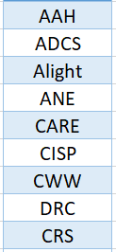
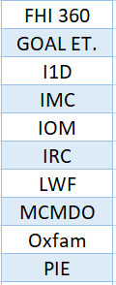
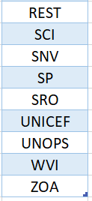
WASH Partners – Reporting - 2023

Slide 113
Emergency Shelter & NFI Cluster Update

Slide 114

Situation update
Since January 2023, the ES/NFI Subnational Cluster has been able to assist 561K individuals which is 45% of the target beneficiaries in the Mekelle, Southern, Southeastern, Eastern, Northwestern, and Central regions, excluding hard-to-reach areas.
Mekelle AoR has experienced significant shelter damage due to a devastating windstorm and heavy rainfall. This natural disaster has impacted on the vulnerable IDPs residing in Mekelle (SC- 4) and Abi Adi (Amohay Tsega feeding center) as it has caused severe disruption to the living conditions and safety of the IDPs exerbating their already precarious situation.
ESNFI cluster partners are conducting damage assessment in the SC-4 to determine the extent of damage to shelters and allocate resources among partners based on the assessment findings.
ESNFI cluster team conducted field mission to Adigrat, Wukro and Edaga Hamus on Meeting with Head of BolSA and site visit on cluster partners planned intervention of Cash for Rent as the coordination is vital to ensure the success and effective implementation of the activity and site visit at Wukro and Edaga Hamus to assess the feasibility to better understand whether to also prioritized the cash for rent intervention in the area.

Slide 115
Situation update…
IOM and DPO have completed the feasibility assessment in Adigrat for the planned cash for rent targeting households dwelling in schools. Awaiting analysis and finding of the assessment before mobilize resources for cash-for-rent program that directly addresses the needs of the most vulnerable beneficiaries.
The Emergency Shelter and Non-Food Items (ESNFI) cluster is working closely with the Camp Coordination and Camp Management (CCCM) cluster to determine the actual number of people in need of sleeping mat and blankets, ensuring accurate data is shared when compiled.
Limited access to safe and adequate shelter options for affected populations, especially IDPs living in merged classes in schools, are experiencing overcrowded conditions, especially situation in Adigrat is particularly alarming, as students who resume schooling share the same compound with IDPs, leading to overcrowding and a lack of separate facilities. Eastern government support is urgently required to secure access to abundant facilities to settle IDPs or explore alternative solutions.

Slide 116
Situation update…
Limited access to safe and adequate shelter options for affected populations, especially IDPs living in merged classes in schools, are experiencing overcrowded conditions, especially situation in Adigrat is particularly alarming, as students who resume schooling share the same compound with IDPs, leading to overcrowding and a lack of separate facilities. Eastern government support is urgently required to secure access to abundant facilities to settle IDPs or explore alternative solutions.
Poor shelter conditions pose severe threats to the health of IDPs merged in classrooms, resulting in overcrowding that falls below the minimum Sphere standards in some IDP sites in Adigrat. As a consequence, cases of children with scabies have been reported. This highlights the critical need to promptly address the shelter situation and improve living conditions.

Slide 117
Accomplishments in the last two weeks
No. | Activity description | Location | Plan | Achievement | % accomplishment | Remark (explanation for over/under achievements
1 | Cash for rent | Enadaba guna | 525 | 525 | 100 | Implementing by IOM
2 | ES repair | Hitsats | 150 | 150 | 100 | Distributed by IOM
3 | Expansion of ES | Hitsats | 70 | 70 | 100 | Maintaining by IOM
4 | Plastic sheet | Shire- Tsehaye IDP site | 200 | 200 | 100 | Distributed by NRC
5 | Partial NFI | Adi aser and T/adiyabo | 200 | 200 | 100 | Implementing by NRC
6 | Cash for rent | Enadabaguna | 500 | 500 | 100 | Distributed by NRC
7 | ES Kit | Hit sats and Shire | 715 | 715 | 100 | Distributed by DEC/UNHCR
8 | Reconstruction of ES | Shire 5 Angle | 10 | 10 | 100 | Constructing by DEC/UNHCR
9 | NFI Kit | Adidaero and Seyemti | 356 | 356 | 100 | Distributed by DEC/UNHCR
10 | Partial NFI | Tsimbla, Adiaser, Adi hageray, May hanse | 6545 | 6545 | 100 | Distributed by DEC/UNHCR
11 | Maintenance of ES | Abiy adi | 9 | 9 | 100 | Maintained by DECUNHCR
Notes:
<number>

Slide 118
Cumulative plan Vs Accomplishments
Cluster Indicators/targets | Cumulative plan | Cumulative Reach | Remark
ESNFI | 331k | 185K | 57%
NFI | 515k | 305K | 62%
Emergency Shelter | 501k | 32K | 6%
Repair Kit | 161k | 39K | 26%

Slide 119
Challenges encountered
Low capacity among the Shelter and NFI partners to adequately respond to surging humanitarian needs.
Influx and relocation of displaced population has led to a surge of humanitarian needs in the region.
Protection concerns, including GBV.
Climate change has exacerbated the humanitarian needs.
Access constraints to some parts of the eastern, central, and Northwestern zones limit much-needed humanitarian response, leading to an influx of IDPs in Shire and surrounding woredas.
Reduced funding for the region versus the huge number of unsupported IDPs

Slide 120
Plan for next week
No. | Activity description | Operational location (woreda) | Plan (qty) | Available resources | Remark (any preconditions, support needs, etc.)
1 | ES repair kit | Dedebit and Tselimoy | 200 | 200 | To be distributed by IOM
2 | ESNFI | Asgede | 388 | 388 | To be distributed by DEC/UNHCR
3 | ESNFI | Tsimbla | 35 | 35 | To be distributed by DEC/UNHCR
4 | ESNFI | Endabaguna | 30 | 30 | To be distributed by DEC/UNHCR
5 | Cash for rent | Adigrat town | 415 | 415 | To be implementing by IOM
6 | Cash for rent | Adigrat twon | 400 | 400 | To be implementing by DPO
7 | Cash for rent | TBA | 834 | 834 | To be implementing by ZOA
8 | ESNFI and ES repair | Central | 2000 | 2000 | To be distributed by SCI

Slide 121

CCCM Cluster Update
Notes:
<number>

Slide 122
Tigray Contextual Update
Food remains the #1 need.
Due to the stalemate of relocation activities in the region, most schools are reopened in the presence of IDPs in the centers. The cluster is working with the Protection Cluster to monitor the situation till relocation is resumed
Most IDPs want to return – the number of IDPs in collective sites is gradually reducing.
CCCM operational activities challenged due to the food suspension. IDPs started to sell Shelter Items from the camp, Suspension of community mobilization/coordination activities and a security towards Social workers.

Slide 123
Response
Partners are continuing with flood preparedness activities. This includes cleaning of drainage canals, distribution of bed nets and awareness creation of Malaria in many IDP sites.
Rehabilitation of damaged shelters in Histas and Five Angels ongoing including roads side and drainage maintenances and excavations.
Maintenance and set up of Communal facilities like Communal kitchen and latrines.
Launched Area base approach to reach IDPs living with Host communities. Distribution of NFIs, Assistive Devices, Case management for GBV survivors and MHPSS services are ongoing in Shire, Axum, Mekelle, Hawzen and Abi Adi.

Slide 124
Challenges, Gaps and Needs
The lack of alternative energy sources has caused severe protection risks like detention and SGBV cases for girls and women.
Absence of cash-based intervention for IDPs in all sites to fulfil their basic humanitarian needs.
Shortages of WASH, NFI, CRI/NFI, and medicines remain significant challenges in most IDP sites.
Security and HLP issues (Land Tilling in Seba care4) are additional challenges.

Slide 125
Next weeks plans
Continue maintenance of flood and rain flooded shelters and communal facilities including preparedness activities.
Continue scale up response in ABA responses and advocacies.
Conducting IDP leaders meeting to ensure AAP actoss the AoRs.

Slide 126
Protection Cluster Update

Slide 127
TIGRAY: Protection Cluster Updates
On July 14, 2023, UNHCR donated gap-based medical items to seven one-stop centers in Tigray region.
UNHCR through BOWA provided NFIs to 200 women/girls in Eastern and Central zones. Also, provided 1,500 women and girls in Abi-Adi with MHM kits. UNHCR in partnership with GBV AoR and FHE provided 3,000 sanitary pads, 2,000 underwear, and 3,000 laundry soap to 1,000 women and girls in Mekelle.
UNHCR/DICAC provided awareness-raising sessions for 507 individuals (F-263) among IDPs and host community on personal hygiene, forms of GBV, PSEA, FGM, and HIV prevention in Maichew, Mekelle, and Abi-Adi.
IOM distributed 500 sanitary pads, 300 soaps, and 300 underwear for women and girls in Mekelle and Wukro collective sites. IOM also distributed 300 kg of Teff to 30 individuals in Sabacare-4, Adiha, Lekatit-23, Messebo and Quiha sites in Mekelle.

Slide 128
TIGRAY: Protection Cluster Updates
UNHCR through its partner EECMY facilitated the restoration of ID card service for 3,432 (F-1,888) who were displaced from Afar and Tigray currently residing in Enderta IDP sites.
UNHCR through its partner EECMY provided 5 computers, 5 printers, 5 Photocopy machines, and stationary materials supporting Maichew Town OSAR, Maichew Justice Office, Maichew Court, and Southern Zone Justice Office.
FTR partners reunified a total of 117 UASC sheltered in Elshadai and different IDP sites in Mekelle. AAH provided multipurpose cash assistance for a total of 89 UASC. IHS and I1D provided scholastic materials to 146 children.
Explosive Ordinance Risk Education (EORE)- Awareness-raising sessions covered 4,223 individuals (F-2,387) among IDPs and host community.
To enhance the knowledge of PSEA, UNICEF provided a one-day training to CP AoR and government staff.
Notes:
<number>

Slide 129
TIGRAY: Protection Cluster Challenges encountered
It is extremely concerning as food aid pause causing extreme hardship and widespread starvation across the region, compromised immune systems and unnatural deaths. Reportedly vulnerable population are increasingly adopting negative coping mechanisms, for instance, child marriage, child labor, begging, transactional sex leading to unintended pregnancies and STI/HIV, collecting UXOs as scrap metals for sale exposing them to the danger.
Abi-Adi reported death of 12 infants, I1D has distributed 150 cartons biscuits.
WASH issues are causes of concerns for the IDPs in Quiha, Alene, Hope, MHC, Lekatit 23, and Momona sites. Ayder and Hayelom IDP sites need protection, WASH, Food, and health services. Two Woredas of Temben, namely Keyih Tekli and Kola Temben where the number of early marriage is alarmingly high require urgent attention from the administration and partners for advocacy.
Notes:
<number>

Slide 130
TIGRAY: Protection Cluster Challenges encountered
  Paramount protection concerns for both IDPs and children where schools are co-located in the same premise or even sharing the space without separation.
  UXOs and ERWs threats are prevalent and remained a serious concern for the safety and security of communities across the region. Reports of incidents are increasing as schools have reopened, farming activities commenced. Awareness raising remained the only MA activity in Tigray.
  Due to presence of external forces in Southern and parts of the Eastern zones, humanitarian access continue to constraint response activities
  Across the region, livelihood interventions and support remained extremely limited slowing people’s ability to recover especially returnees.
Notes:
<number>

